Slide 1

ANDROID
🗓️2-3 December 2023
🕘09:30 - 16:30
📍At geeky base

Slide 2
Android Course
Project structure
Gradle Configuration
minSDK
compileSDK
targetSDK
Context
Resource
String
Theme
Style
Attr
Manifest
Layout1
ViewGroup
View
TextView
Button
ImageView
Kotlin part 1
Variable Declaration
Type
Nullable
expression
Control flow
condition
loop
Working with null
collection
List
Set
Pair

Slide 3
Android Course
Kotlin part 1 (con.)
Function
First class function
Scope function
Extension function
Higher order function
Lamda
Inline functions
Operator function
infix function
Kotlin part 1 (con.)
Class and Object
Class
Visibility modifiers
Data class
Enum class
Seal class
Activity
Lifecycle
startActivity
Pass data between activity
Device
Support different pixel densities

Slide 4
Android Course
Layout part2
View
RecyclerView
Handle action to view
Fragment
Lifecycle
supportFragment manager
Navigation component
Architecture component
View binding
ViewModel
Lifecycler aware
Presentation architecture MVVM
Dependencies injection
Permission
Connect APIs
Kotlin part 2
Coroutine
Flow
Data and file storage
App specific storage
Share storage
Preference
Database
Loading image
Handle state lifecycle
Repository

Slide 5


Slide 6
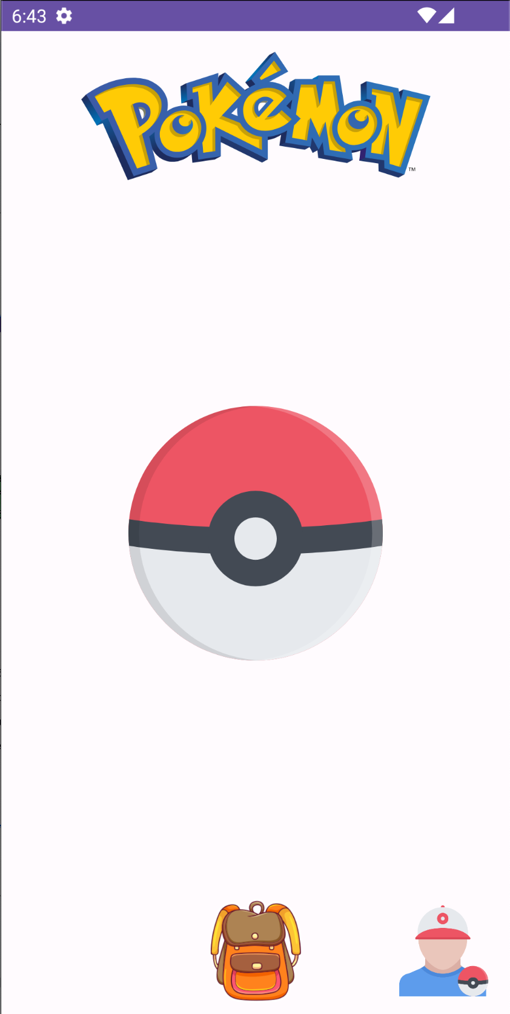
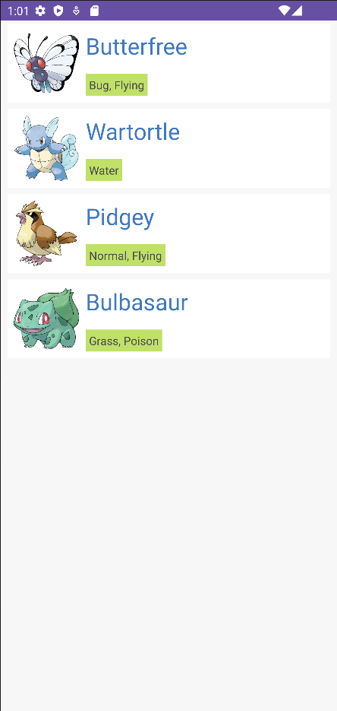
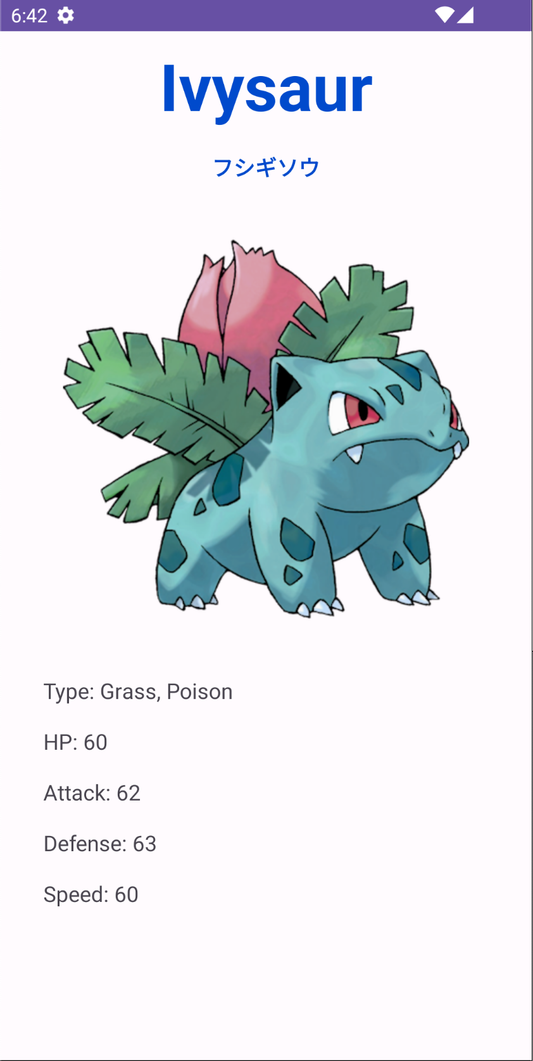

Slide 7
Project Structure

Slide 8
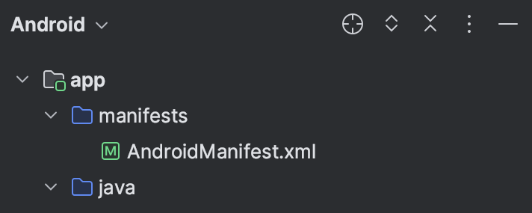
Project Structure
App
the central module responsible for the main functionality of the Android application.
can be more than one app module in a project, especially in complex applications with features
AndroidManifest.xml
contains information of your package, including components of the application such as activities, services, broadcast receivers, content providers etc.

Slide 9
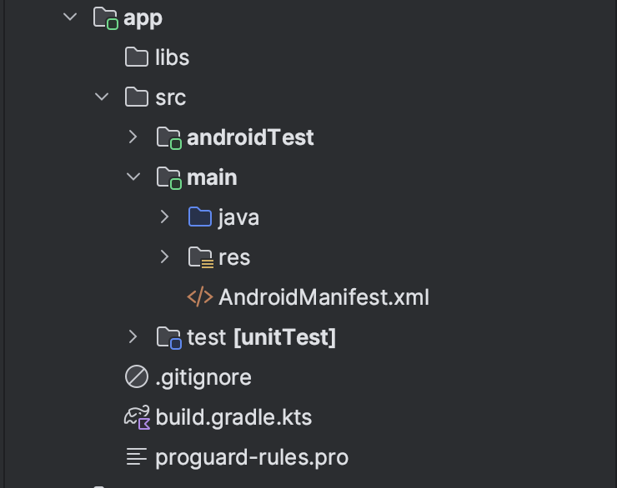
Project Structure
Main
contains the main source code for Android application.
Src folder is non-code resources such as layouts, drawables, values, and other assets used by application.
AndroidTest for UI test
Test for Unit Test

Slide 10
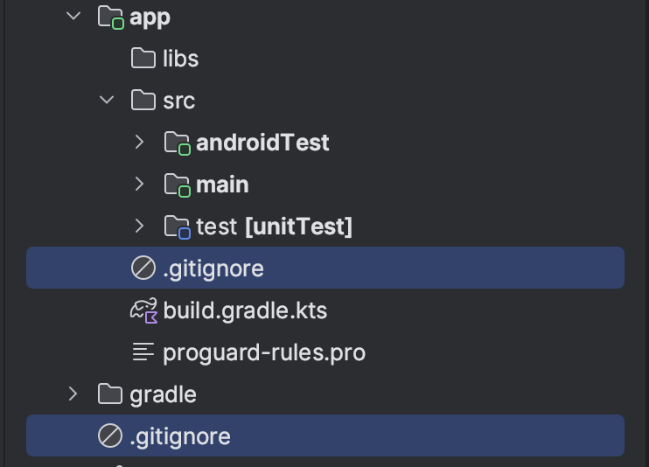
Project Structure
.gitignore
It specifies which files to be excluded from your repository systems eg GitHub.

Slide 11
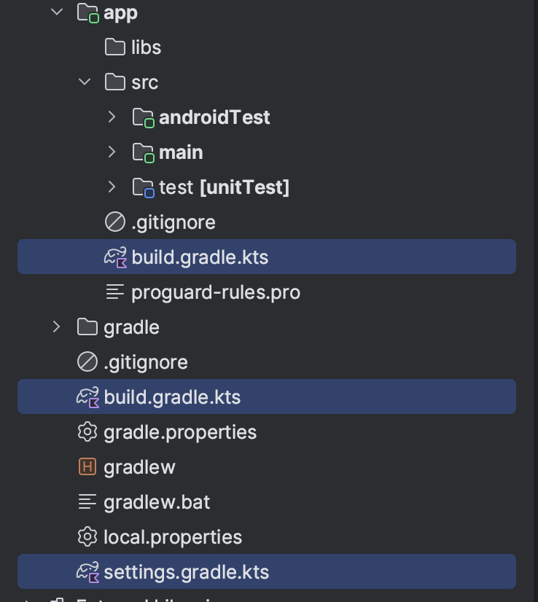
Project Structure
Build.gradle (first)
For app module
Build.gradle.kts (second)
For project
Setting.gradle.kts
informs Gradle which modules it should include when building your app
https://gist.github.com/JackleStyle0/ad230390d4e462e6804b77d325d4202b

Slide 12
Configure
minSDK
compileSDK
targetSDKPlatform architecture
dependencies

Slide 13
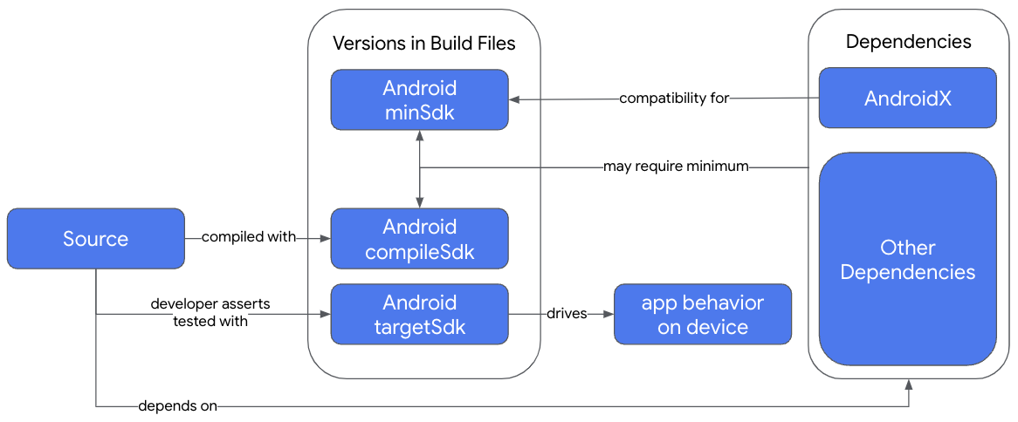
SDK settings

Slide 14
compileSdk

Slide 15
minSdk

Slide 16
targetSdk

Slide 17
Context

Slide 18
How does context work
Accessing resources like strings, layouts, and drawables.
Launching activities, services, and broadcasts.
Accessing the application’s package information.
Accessing the system services, like the notification manager or alarm manager.

Slide 19
How does context work
Application context
Activity context

Slide 20
Activity context
This context is tied to the Application’s lifecycle
The function invoking in the Activity context is
getContext()
// or
Activity.this

Slide 21
Functionalities of Application context
Load Resource Values
Start a Service
Bind to a Service
Send a Broadcast
Register BroadcastReceiver

Slide 22
Activity context
This context is tied to the Activity lifecycle
It is an instance that is a singleton and can be accessed by
getApplicationContext()
// or
applicationcontext

Slide 23
Functionalities of Activity context
Load Resource Values
Layout Inflation
Start an Activity
Show a Dialog
Start a Service
Bind to a Service
Send a Broadcast
Register BroadcastReceiver

Slide 24
Context Compat
From package in Androidx
ContextCompat is a utility class that allows you to work with the Context object in a backward-compatible way

Slide 25
Resource
Strings
Styles
Colors
Dimens
Layout

Slide 26
Resource types
Animation res/anim/
Color state list res/color/
Drawable* res/drawable/
Layout* res/layout/
Menu res/menu/
String* res/values/
Style* res/values/
Font res/font/
More resource types
Boolean
Color*
Dimension*
ID*
Integer
Integer Array
Type Array

Slide 27
Access resource
Access drawable in directory res/drawable/ from class R.drawable

Slide 28
Use contextCompat to get resource
val appName = ContextCompat.getString(context, R.string.app_name)
val margin = ContextCompat.getDimension(context, R.dimen.margin)
val colorPrimary = ContextCompat.getColor(context, R.color.colorPrimary)
val appIcon = ContextCompat.getDrawable(context, R.drawable.app_icon)

Slide 29
Manifest

Slide 30
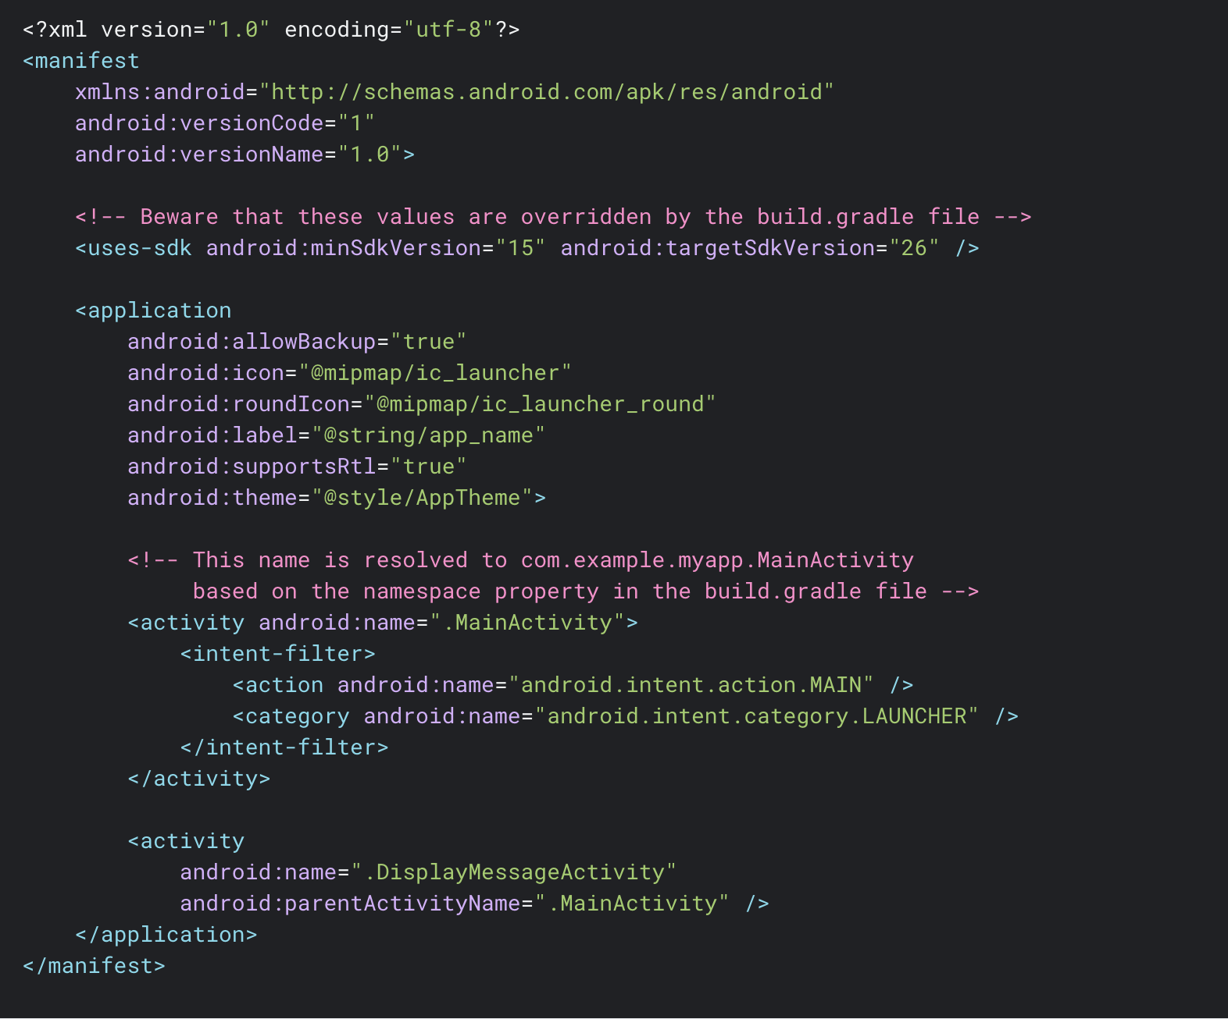
Example file

Slide 31
App components
There are four types of app components
Activities <activity>*
Services <service>
Broadcast receivers <receiver>
Content providers <provider>

Slide 32
Device
Support different pixel densities

Slide 33
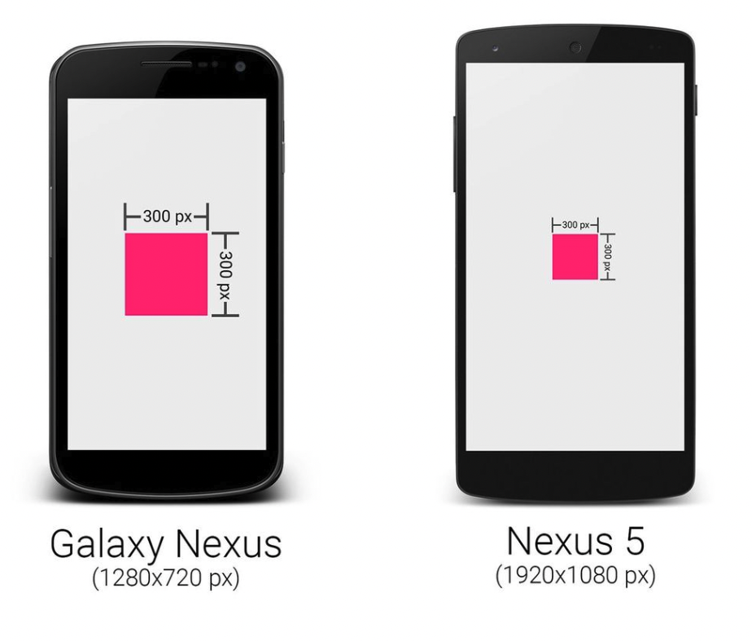
Support different pixel densities
“Android devices have screens with different pixel sizes”

Slide 34

Support different pixel densities
Use density-independent pixels (dp)
Specifying text size, always use scalable pixels (sp)

Slide 35
Layout part1
View Group (Linear, constraint)
View
Text, Button. ImageView
Notes:
10:50 - 11:10

Slide 36
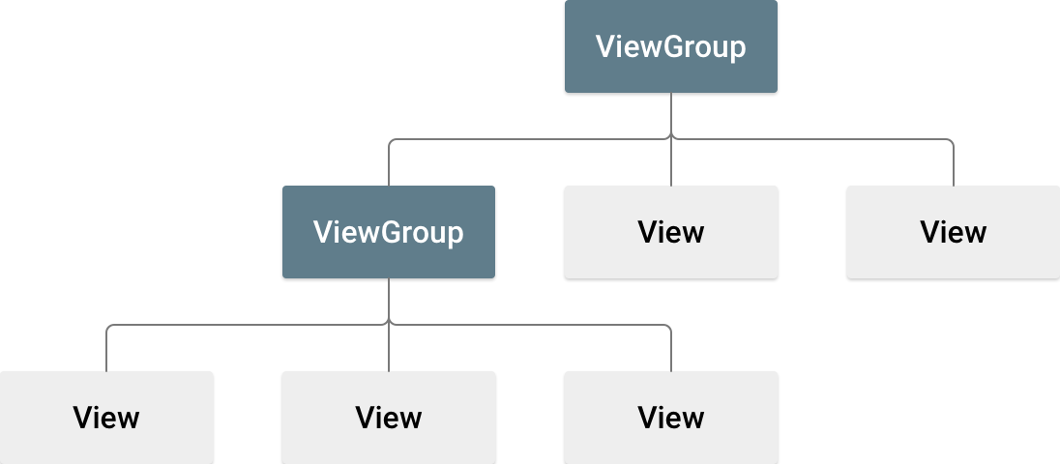
Layout

Slide 37
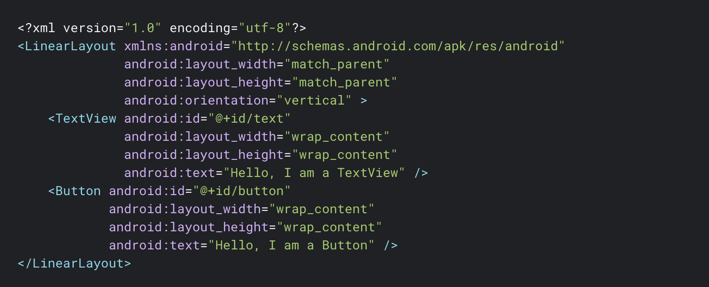
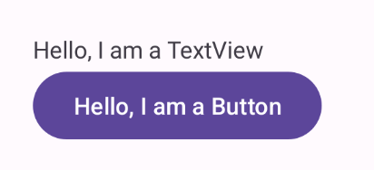
Xml file

Slide 38
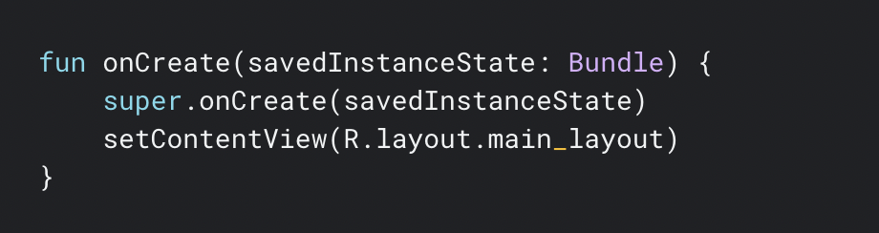
Load XML Resource

Slide 39
Common ViewGroup
LinearLayout*
ConstraintLayout*
FrameLayout
ScrollView

Slide 40
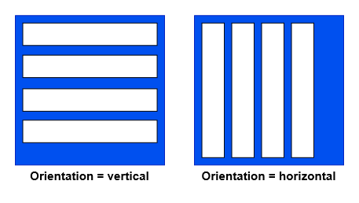
LinearLayout

Slide 41

LinearLayout: Orientation
<?xml version="1.0" encoding="utf-8"?>
<LinearLayout xmlns:android="http://schemas.android.com/apk/res/android"
android:layout_width="match_parent"
android:layout_height="match_parent"
android:orientation="vertical">
.
.
</LinearLayout>

Slide 42

LinearLayout: Orientation
<?xml version="1.0" encoding="utf-8"?>
<LinearLayout xmlns:android="http://schemas.android.com/apk/res/android"
android:layout_width="match_parent"
android:layout_height="match_parent"
android:orientation="horizontal">
.
.
</LinearLayout>

Slide 43

LinearLayout: layout_weight
<LinearLayout
android:layout_width="match_parent"
android:layout_height="match_parent"
android:weightSum="3"
android:orientation="vertical">
<View
android:layout_width="match_parent"
android:layout_height="0dp"
android:layout_weight="1"
android:background="#ffaa" />
<View
android:layout_width="match_parent"
android:layout_height="0dp"
android:layout_weight="1"
android:background="#ffbb" />
<View
android:layout_width="match_parent"
android:layout_height="0dp"
android:layout_weight="1"
android:background="#ffcc" />
</LinearLayout>

Slide 44
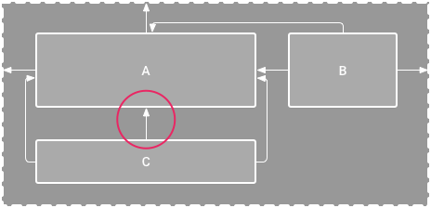
ConstraintLayout

Slide 45
ConstraintLayout
The fundamental concept behind solving performance problems that arise from view hierarchies can be difficult in practice. Preventing view hierarchies from imposing performance penalties consists of flattening your view hierarchy and reducing double taxation. This section discusses strategies for pursuing these goals.
Flat view hierarchy in layouts

Slide 46
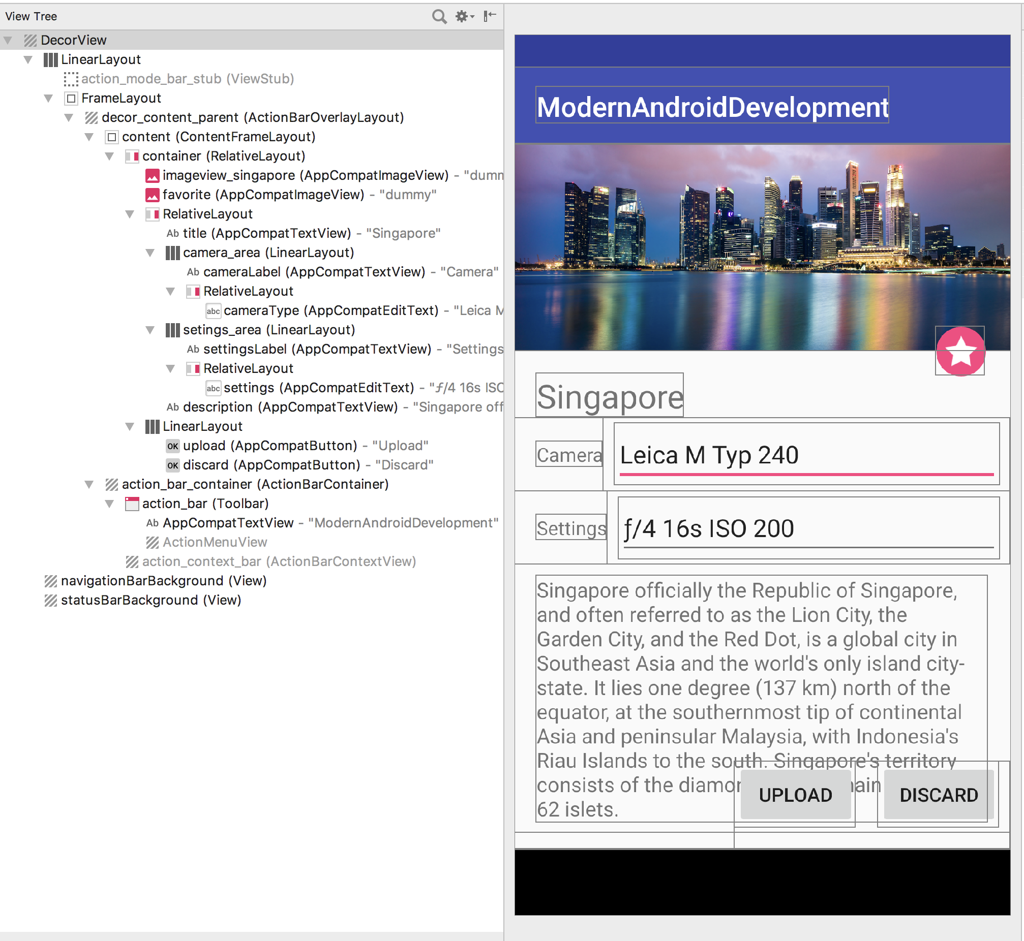
View Hierarchy - Traditional layout

Slide 47
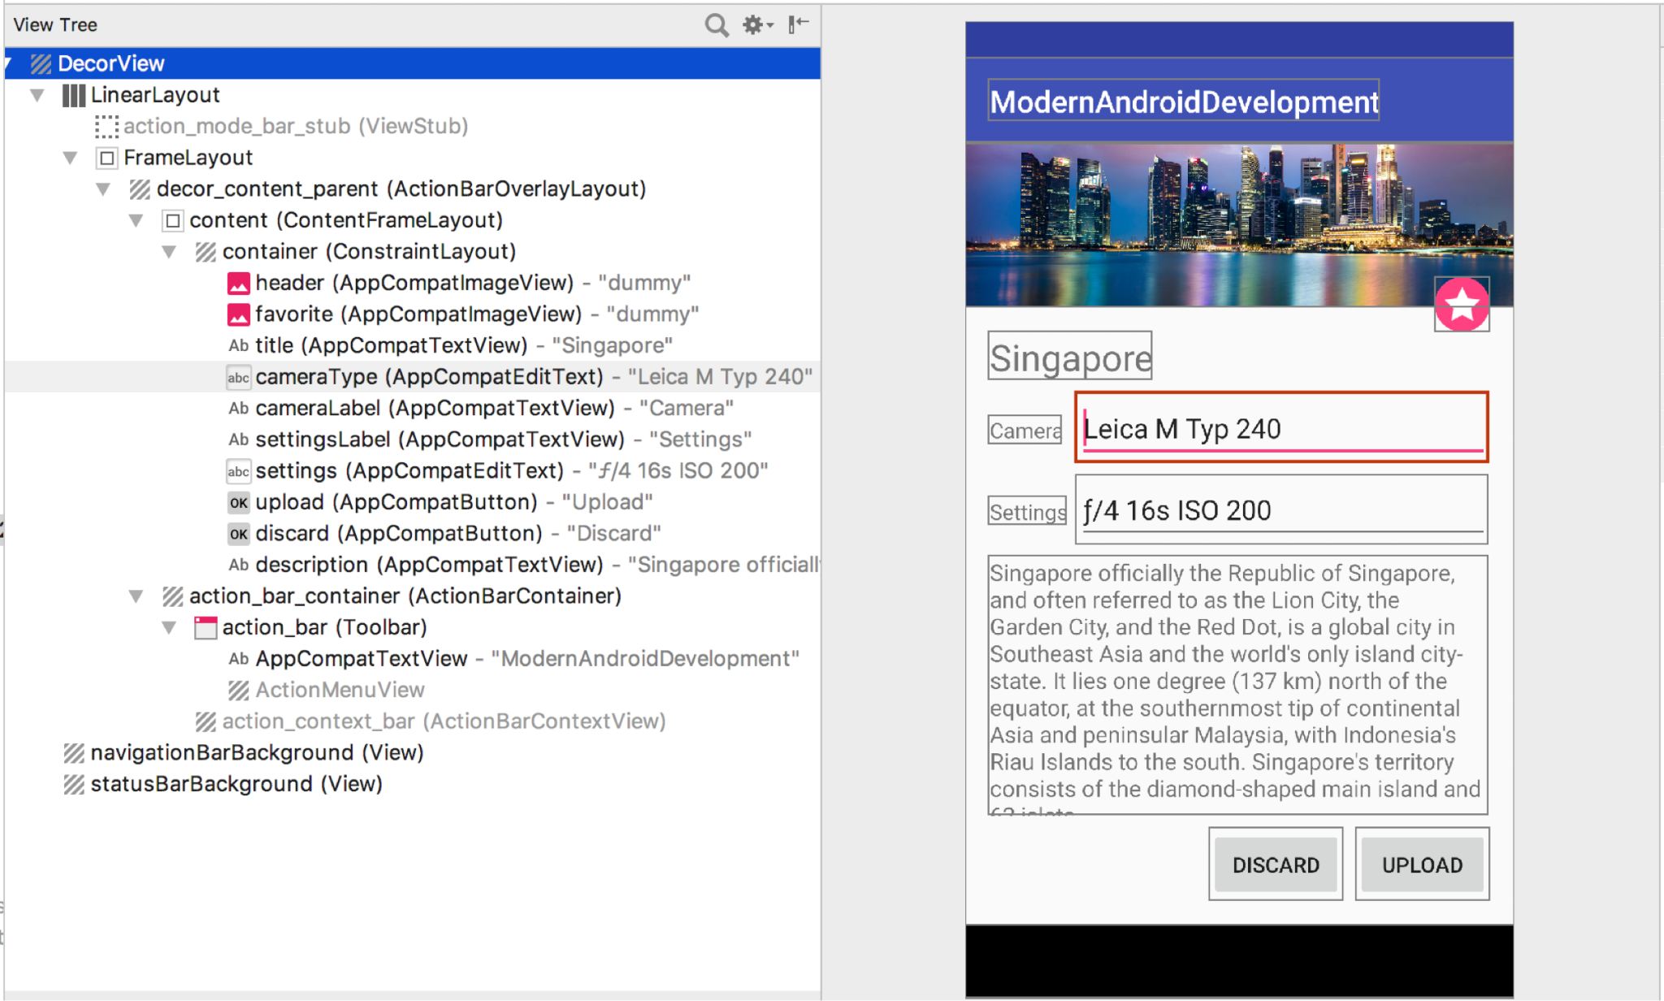
View Hierarchy - Constraint layout

Slide 48
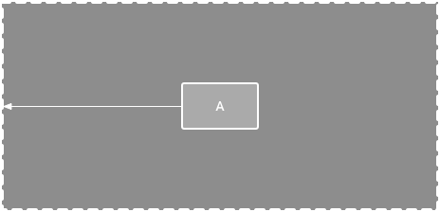
Add Constraint with parent

Slide 49
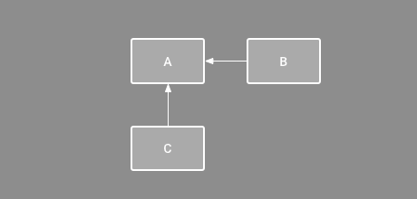
Order position of view

Slide 50
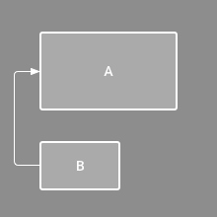
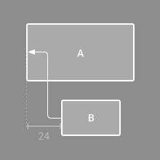
Alignment

Slide 51
XML Code - Constraint layout
layout_constraint<SOURCE_SIDE>_to<TARGET_SIDE>=“<TARGET_ID>”
SOURCE_SIDE / TARGET_SIDE
Vertical
Start
End
Horizontal
Top
Bottom
layout_constraintStart_toStartOf="parent"
layout_constraintTop_toBottomOf="@+id/pokemonImage"

Slide 52
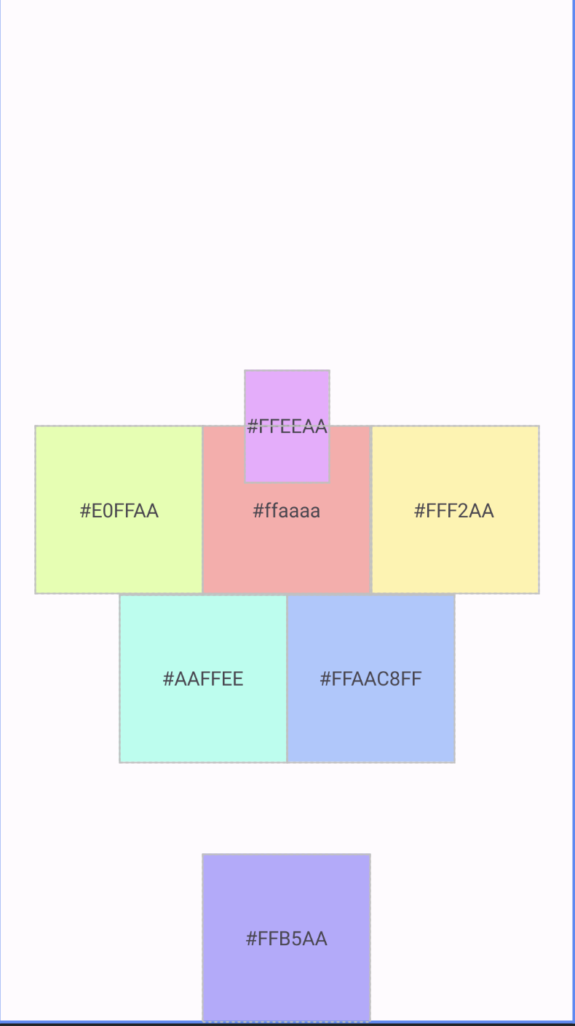
try to add constraint to view
Width = 60dp
Height = 80dp
https://gist.github.com/JackleStyle0/3dcac4b06caacec2928bd148d5620fc5
Notes:
11:10 - 11:30

Slide 53
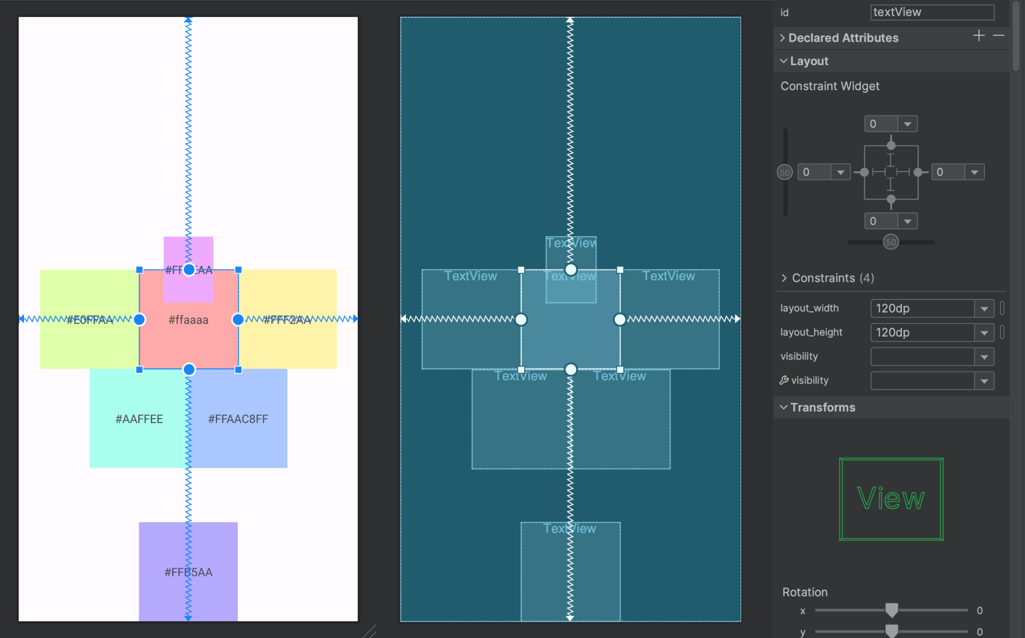

Slide 54

Create view for homePokemon
PokeBall
Width: 0dp
Height: 0dp
Ratio: 2:1
Backpack
Width: 70dp
Height: 90dp
scaleType: centerCrop
Notes:
11:30 - 12:00

Slide 55
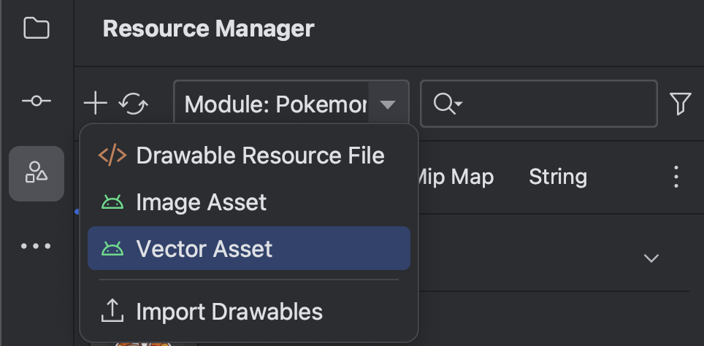
Add new SVG image

Slide 56
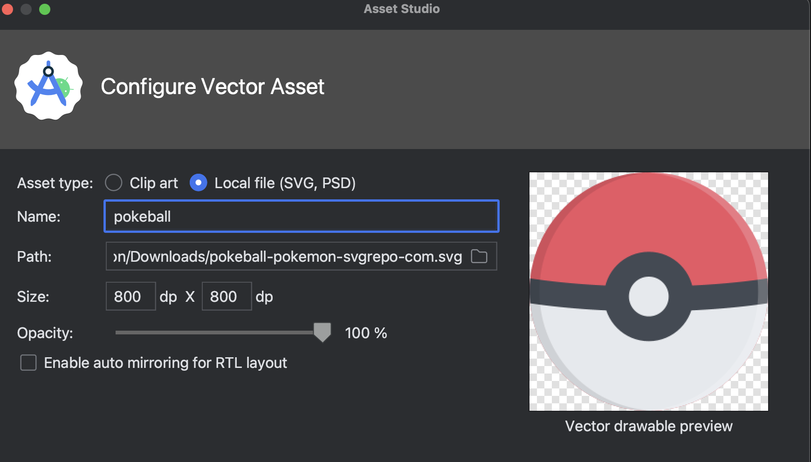
Add new SVG image

Slide 57
Kotlin part 1
Variable Declaration
Type
Nullable
expression
Control flow
condition
loop
Working with null
collection
List
Set
Pair
Function
First class function
Scope function
Extension function
Higher order function
Lamda
Inline functions
Operator function
infix function
Class and Object
Class
Visibility modifiers
Data class
Enum class
Seal class
Notes:
13:00 - 14:30 (1hr 30mins)

Slide 58
Basic types
Numbers
Characters﻿
Integer types﻿
Byte
Short
Int
Long
Floating-point types﻿
Flot
Double
Char
Booleans﻿
Boolean

Slide 59
Strings
Basic types
Strings in Kotlin are represented by the type String. Generally, a string value is a sequence of characters in double quotes ("):
val str = "abcd 123"

Slide 60
String literals﻿
Basic types
Escaped strings﻿
Escaped strings can contain escaped characters.
Here's an example of an escaped string:
val s = "Hello, world!\n"
Escaping is done in the conventional way, with a backslash (\). See Characters page for the list of supported escape sequences.

Slide 61
String templates﻿
Basic types
String literals may contain template expressions – pieces of code that are evaluated and whose results are concatenated into the string. A template expression starts with a dollar sign ($) and consists of either a name:
val i = 10
println("i = $i")
// i = 10
val s = "abc"
println("$s.length is ${s.length}")
// abc.length is 3

Slide 62
Type checks and casts﻿
is and !is operators﻿
Use the is operator or its negated form !is to perform a runtime check that identifies whether an object conforms to a given type:
if (obj is String) {
print(obj.length)
}
if (obj !is String) { // Same as !(obj is String)
print("Not a String")
} else {
print(obj.length)
}

Slide 63
Type checks and casts﻿
"Unsafe" cast operator﻿
Usually, the cast operator throws an exception if the cast isn't possible. Thus, it's called unsafe. The unsafe cast in Kotlin is done by the infix operator as
val x: String = y as String
"Safe" (nullable) cast operator﻿
To avoid exceptions, use the safe cast operator as?, which returns null on failure.
val x: String? = y as? String

Slide 64
Condition Expression

Slide 65
Conditional expressions
if
In Kotlin, if is an expression: it returns a value. Therefore, there is no ternary operator (condition ? then : else) because ordinary if works fine in this role.
var max = a if (a < b) max = b // With else if (a > b) { max = a } else { max = b } // As expression max = if (a > b) a else b

Slide 66
Conditional expressions
when
Use when when you have a conditional expression with multiple branches. when can be used either as a statement or as an expression.
val x = 1 when (x) { 1 -> print("x == 1") 2 -> print("x == 2") else -> { print("x is neither 1 nor 2") } }

Slide 67
Conditional expressions
when
To define a common behavior for multiple cases, combine their conditions in a single line with a comma:
val x = 1 when (x) { 0, 1 -> print("x == 0 or x == 1") else -> print("otherwise") }
when can also be used as a replacement for an if-else if chain
when { x.isOdd() -> print("x is odd") y.isEven() -> print("y is even") else -> print("x+y is odd") }

Slide 68
Loops

Slide 69
For Loops
for (item: Int in ints) { print(item) } //range expression for (i in 1..3) { println(i) } for (i in 6 downTo 0 step 2) { println(i) }
//iterate through an array or a list with an index val array = arrayOf("a", "b", "c") for (i in array.indices) { println(array[i]) } //sample use the withIndex library function val array = arrayOf("a", "b", "c") for ((index, value) in array.withIndex()) { println("the element at $index is $value") }

Slide 70
While Loops
while
while checks the condition and, if it's satisfied, executes the body and then returns to the condition check.
while (x > 0) { x-- }
do-while
executes the body and then checks the condition. If it's satisfied, the loop repeats.
do { val y = retrieveData() } while (y != null) // y is visible here!

Slide 71
Null Safety
Null safety is a combination of features that allow you to:
explicitly declare when null values are allowed in your program.
check for null values.
use safe calls to properties or functions that may contain null values.
declare actions to take if null values are detected.
var a: String = "abc" // Regular initialization means non-nullable by default a = null // compilation error
var b: String? = "abc" // can be set to null b = null // ok

Slide 72
Null Safety
Checking for null in conditions﻿
val l = if (b != null) b.length else -1
Safe calls
val a = "Kotlin" val b: String? = null println(b?.length) println(a?.length) // Unnecessary safe call
Elvis operator﻿
val l: Int = if (b != null) b.length else -1 // normal val l = b?.length ?: -1 // elvis operator

Slide 73
Null Safety
The !! operator (not-null assertion)
val l = b!!.length
Safe casts
val aInt: Int? = a as? Int
Collections of a nullable type
val nullableList: List<Int?> = listOf(1, 2, null, 4) val intList: List<Int> = nullableList.filterNotNull()

Slide 74
Collections

Slide 75
List
Collection
List<T>
stores elements in a specified order and provides indexed access to them.
Indices start from 0 (the index of the first element) and go to lastIndex (list.size - 1).
val numbers = listOf("one", "two", "three", "four") println("Number of elements: ${numbers.size}") println("Third element: ${numbers.get(2)}") println("Fourth element: ${numbers[3]}") println("Index of element \"two\" ${numbers.indexOf("two")}")
Output:
Number of elements: 4
Third element: three
Fourth element: four
Index of element "two" 1

Slide 76
List
Collection
MutableList
a List with list-specific write operations, for example, to add or remove an element
at a specific position
val numbers = mutableListOf(1, 2, 3, 4) numbers.add(5) numbers.removeAt(1) numbers[0] = 0 numbers.shuffle() println(numbers)
Output:
[4, 3, 5, 0]

Slide 77
Set
Collection
Set<T>
contains a collection of unique elements without a specific order
null elements are unique as well, a Set can contain only one null
two sets are equal if they have the same size, and for each element of a set there is an equal element in the other set.
val numbers = setOf(1, 2, 3, 4) println("Number of elements: ${numbers.size}") //Number of elements: 4 if (numbers.contains(1)) println("1 is in the set") //1 is in the set val numbersBackwards = setOf(4, 3, 2, 1) println("sets are equal ${numbers == numbersBackwards}") //sets are equal true

Slide 78
Set
Collection
MutableSet
is a Set with write operations from MutableCollection
val set = mutableSetOf<Int>() println("set.isEmpty() is ${set.isEmpty()}") // true set.add(1) set.add(2) set.add(3) set.add(1) println(set) // [1, 2, 3] set.remove(1) println(set) // [2, 3]

Slide 79
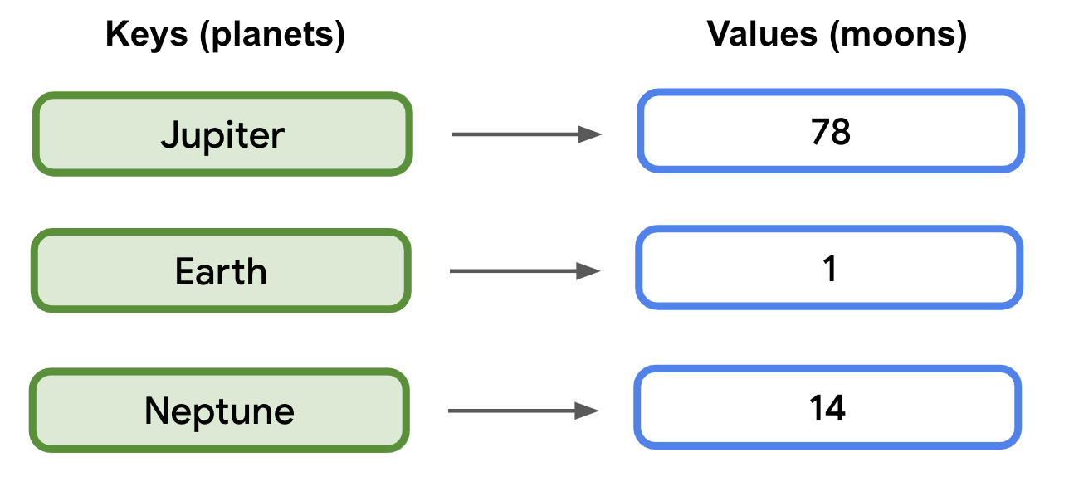
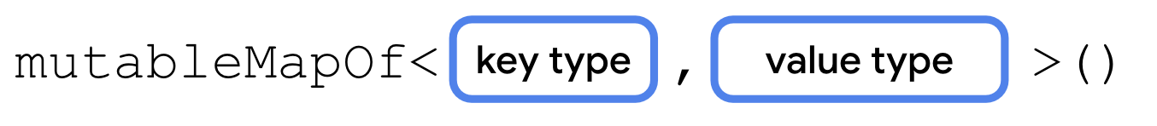
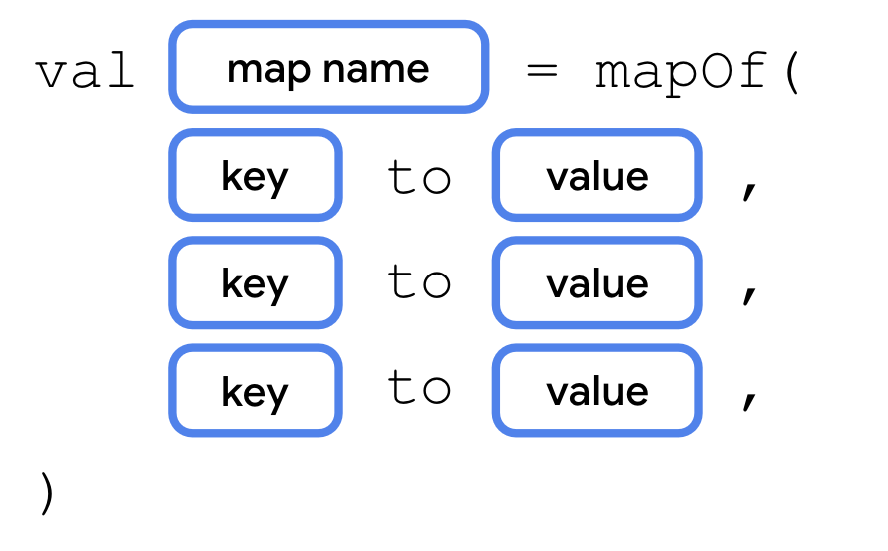
Map
Collection
Map<K,V>
keys are unique, and each of them maps to exactly one value.
The values can be duplicates.
Maps are useful for storing logical connections between objects
can be declared using the mapOf() or mutableMapOf()

Slide 80
Map
Collection
Ex. mutableMapOf()
val solarSystem = mutableMapOf( "Jupiter" to 78, "Earth" to 1, "Neptune" to 14 ) println(solarSystem.size) // 3 solarSystem["Pluto"] = 5 // add key Pluto println(solarSystem.size) // 4 println(solarSystem["Pluto"]) // value of Pluto is 5 println(solarSystem["Mars"]) // null solarSystem.remove("Pluto") println(solarSystem.size) // 3

Slide 81
Pair
Collection
Pair<out A, out B>
Represents a generic pair of two values
A - type of the first value
B - type of the second value
val (a, b) = Pair(1, "x")
println(a)
println(b)
val value = Pair(1, "x")
println(value.first)
println(value.second)
Output:
1
x

Slide 82
Functions﻿

Slide 83
Functions﻿
Functions﻿
Kotlin functions are declared using the fun keyword:
fun double(x: Int): Int {
return 2 * x
}
Function usage﻿
val result = double(2)

Slide 84
Parameters﻿
Functions﻿
Function parameters are defined using Pascal notation - name: type. Parameters are separated using commas, and each parameter must be explicitly typed:
fun powerOf(number: Int, exponent: Int): Int { /*...*/ }

Slide 85
Default arguments﻿
Functions﻿
Function parameters can have default values, which are used when you skip the corresponding argument. This reduces the number of overloads:
fun read(
b: ByteArray,
off: Int = 0,
len: Int = b.size,
) { /*...*/ }

Slide 86
Single-expression functions﻿
Functions﻿
When the function body consists of a single expression, the curly braces can be omitted and the body specified after an = symbol:
fun double(x: Int): Int = x * 2
Explicitly declaring the return type is optional when this can be inferred by the compiler:
fun double(x: Int) = x *

Slide 87
First Class Function
Functions﻿
A programming language that supports first-class functions allows you to:
Assign a function to a variable
Pass a function to another function as an argument
Return a function from another function as a result
There are a few different ways that you can assign a function to a variable in Kotlin.
Anonymous Function
val add = fun(a: Int, b: Int) = a + b
Lambda
val subtract = { a: Int, b: Int -> a - b }

Slide 88
First Class Function
Functions﻿
Function Reference
class Example {
fun add(a: Int, b: Int) = a + b
fun mlt(a: Int, b: Int) = a * b
fun doIt(operation: (Int, Int) -> Int) {
operation.invoke(2, 3)
}
fun doAdd() = doIt(this::add)
fun doMultiply() = doIt(this::mlt)
}

Slide 89
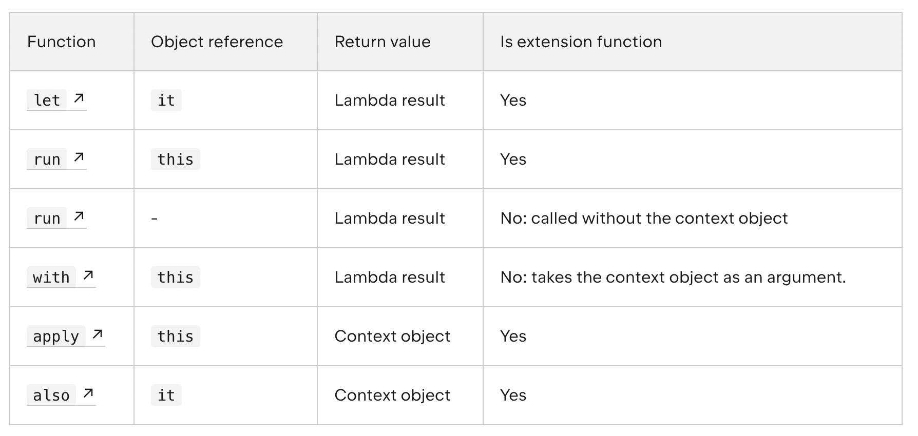
Scope functions
Functions﻿
In this scope, you can access the object without its name. Such functions are called scope functions. There are five of them: let, run, with, apply, and also

Slide 90
Scope functions
Functions﻿
fun main() {
val str = "Hello"
// this
str.run {
println("The string's length: $length")
//println("The string's length: ${this.length}") // does the same
}
// it
str.let {
println("The string's length is ${it.length}")
}
}

Slide 91
Extension functions﻿
Functions﻿
To declare an extension function, prefix its name with a receiver type, which refers to the type being extended. The following adds a swap function to MutableList<Int>:
fun MutableList<Int>.swap(index1: Int, index2: Int) {
val tmp = this[index1] // 'this' corresponds to the list
this[index1] = this[index2]
this[index2] = tmp
}
The this keyword inside an extension function corresponds to the receiver object (the one that is passed before the dot). Now, you can call such a function on any MutableList<Int>:
val list = mutableListOf(1, 2, 3)
list.swap(0, 2) // 'this' inside 'swap()' will hold the value of 'list'

Slide 92
Inline functions
Functions﻿
Using higher-order functions imposes certain runtime penalties: each function is an object, and it captures a closure. A closure is a scope of variables that can be accessed in the body of the function. Memory allocations (both for function objects and classes) and virtual calls introduce runtime overhead.
Higher-order Functions
fun startHere() {
var addResult = calculate(10, 3, { x, y -> x + y })
...
}
fun calculate(x: Int,y: Int,equation: (x: Int, y: Int) -> Int): Int {
// Do something
return equation(x, y)
}

Slide 93
Inline functions
Functions﻿
Decompile to JAVA
public final void startHere() {
int addResult = this.calculate(10, 3, (Function2)null.INSTANCE);
...
}
public final int calculate(int x, int y, @NotNull Function2 equation) {
Intrinsics.checkParameterIsNotNull(equation, "equation");
// Do something
return ((Number)equation.invoke(x, y)).intValue();
}
If use this function in loop?

Slide 94
Inline functions
Functions﻿
mark the calculate() function with the inline modifier:
fun startHere() {
for (index in 0..100) {
var addResult = calculate(10, index, { x, y ->x + y })
...
}
}
inline fun calculate(x: Int, y: Int, equation: (x: Int, y: Int) -> Int): Int {
// Do something
return equation(x, y)
}

Slide 95
Inline functions
Functions﻿
Decompile to JAVA
public final void startHere() {
int index = 0;
for(byte var2 = 100; index <= var2; ++index) {
int x$iv = 10;
// Do something
int addResult = x$iv + index;
...
}
}
public final int calculate(int x, int y, @NotNull Function2 equation) {
Intrinsics.checkParameterIsNotNull(equation, "equation");
return ((Number)equation.invoke(x, y)).intValue();
}

Slide 96
Infix notation﻿
Functions﻿
Functions marked with the infix keyword can also be called using the infix notation (omitting the dot and the parentheses for the call). Infix functions must meet the following requirements:
They must be member functions or extension functions.
They must have a single parameter.
The parameter must not accept variable number of arguments and must have no default value.
infix fun Int.plus(a: Int): Int {
return this + a;
}
fun main() {
println("1 plus 5 is: ${1 plus 5}")
println("1 plus 5 using regular invocation is : ${1.plus(5)}")
}
//1 plus 5 is: 6
//1 plus 5 using regular invocation is : 6

Slide 97
Generic function
Functions﻿
Type parameters are placed before the name of the function:
fun <T> singletonList(item: T): List<T> { ... }
fun <T> T.basicToString(): String { // extension function
}
fun <T : Comparable<T>> sort(list: List<T>) { ... }
To call a generic function, specify the type arguments at the call site after the name of the function:
val l = singletonList<Int>(1)
Type arguments can be omitted if they can be inferred from the context, so the following example works as well:
val l = singletonList(1)

Slide 98
Classes and Objects

Slide 99
Classes﻿
Classes and Objects
Classes in Kotlin are declared using the keyword class:
class Person { /*...*/ }

Slide 100
Constructors﻿
Classes and Objects
A class in Kotlin has a primary constructor and possibly one or more secondary constructors. The primary constructor is declared in the class header, and it goes after the class name and optional type parameters.
class Person constructor(firstName: String) { /*...*/ }

Slide 101
Constructors﻿
Classes and Objects
During the initialization of an instance, the initializer blocks are executed in the same order as they appear in the class body, interleaved with the property initializers:
class InitOrderDemo(name: String) {
val firstProperty = "First property: $name".also(::println)
init {
println("First initializer block that prints $name")
}
}
fun main() {
InitOrderDemo("hello")
}
//First property: hello
//First initializer block that prints hello

Slide 102
Constructors﻿
Classes and Objects
Such declarations can also include default values of the class properties:
class Person(val firstName: String, val lastName: String, var isEmployed: Boolean = true)
Much like regular properties, properties declared in the primary constructor can be mutable (var) or read-only (val).
If the constructor has annotations or visibility modifiers, the constructor keyword is required and the modifiers go before it:
class Customer public @Inject constructor(name: String) { /*...*/ }

Slide 103
Creating instances of classes﻿
Classes and Objects
To create an instance of a class, call the constructor as if it were a regular function:
val invoice = Invoice()
val customer = Customer("Joe Smith")
*Kotlin does not have a “new” keyword.

Slide 104
Data classes﻿
Classes and Objects
Data classes in Kotlin are classes whose main purpose is to hold data. Data classes come automatically with additional member functions that allow you to print an instance to readable output, compare instances, copy instances, and more. Data classes are marked with data:
data class User(val name: String, val age: Int)
Copying﻿
val jack = User(name = "Jack", age = 1)
val olderJack = jack.copy(age = 2)
Data classes and destructuring declarations﻿
val jane = User("Jane", 35)
val (name, age) = jane
println("$name, $age years of age")
// Jane, 35 years of age

Slide 105
Enum classes﻿
Classes and Objects
enum class Direction {
NORTH, SOUTH, WEST, EAST
}
Since each enum is an instance of the enum class, it can be initialized as:
enum class Color(val rgb: Int) {
RED(0xFF0000),
GREEN(0x00FF00),
BLUE(0x0000FF)
}

Slide 106
Working with enum constants﻿
Classes and Objects
Enum classes in Kotlin have synthetic properties and methods for listing the defined enum constants and getting an enum constant by its name. The signatures of these methods are as follows (assuming the name of the enum class is EnumClass):
EnumClass.valueOf(value: String): EnumClass
EnumClass.entries: EnumEntries<EnumClass> // specialized List<EnumClass>
enum class RGB { RED, GREEN, BLUE }
fun main() {
for (color in RGB.entries) println(color.toString()) // prints RED, GREEN, BLUE
println("The first color is: ${RGB.valueOf("RED")}") // prints "The first color is: RED"
}

Slide 107
Sealed class
Classes and Objects
Sealed classes and interfaces represent restricted class hierarchies that provide more control over inheritance. All direct subclasses of a sealed class are known at compile time. No other subclasses may appear outside the module and package within which the sealed class is defined
Sealed Class cannot be instantiated because it is an abstract class.
Constructors of Sealed Class are private by default.
All subclasses of a Sealed Class must be declared under the same file.
sealed class A {
class B : A()
class C : A()
}
fun main(args: Array<String>) {
var a = A() //compiler error. Class A cannot be instantiated.
}

Slide 108
Sealed class
Classes and Objects
enum class PaymentEnumNormal {
CREDIT_CARD, CASH_BANK, PROMTPAY, NONE
}
data class CreditCard(
val name: String,
val number: String,
val expiredDate: String,
val transferAmount: Double
)
data class CashBank(
val bankCode: String,
val bankName: String,
val transferAmount: Double
)
data class Promptpay(
val name: String,
val citizenId: String,
val mobileNumber: String,
val transferAmount: Double
)
sealed class Payment {
data class CreditCard(
val name: String,
val number: String,
val expiredDate: String,
val transferAmount: Double
) : Payment()
data class CashBank(
val bankCode: String,
val bankName: String,
val transferAmount: Double
) : Payment()
data class Promptpay(
val name: String,
val citizenId: String,
val mobileNumber: String,
val transferAmount: Double
) : Payment()
object NonePayment : Payment()
}

Slide 109
Activity
Lifecycle
StartActivity
Pass data between activity
Notes:
14:30 - 15:30

Slide 110
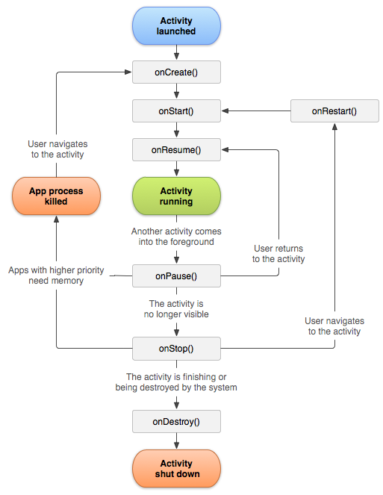
Activity lifecycle

Slide 111
Enable viewBinding
// build.gradle (module app)
android {
…
buildFeatures {
viewBinding = true
}
}

Slide 112
Ignore layout from generate binding
<LinearLayout
…
tools:viewBindingIgnore="true"
>
…
</LinearLayout>

Slide 113
Use view binding in activity
private lateinit var binding: ActivityMainBinding
override fun onCreate(savedInstanceState: Bundle?) {
super.onCreate(savedInstanceState)
binding = ActivityMainBinding.inflate(layoutInflater)
setContentView(binding.root)
}

Slide 114
Handle action on view
private lateinit var binding: ActivityMainBinding
override fun onCreate(savedInstanceState: Bundle?) {
...
binding.pokeBall.setOnClickListener {
...
}
}

Slide 115
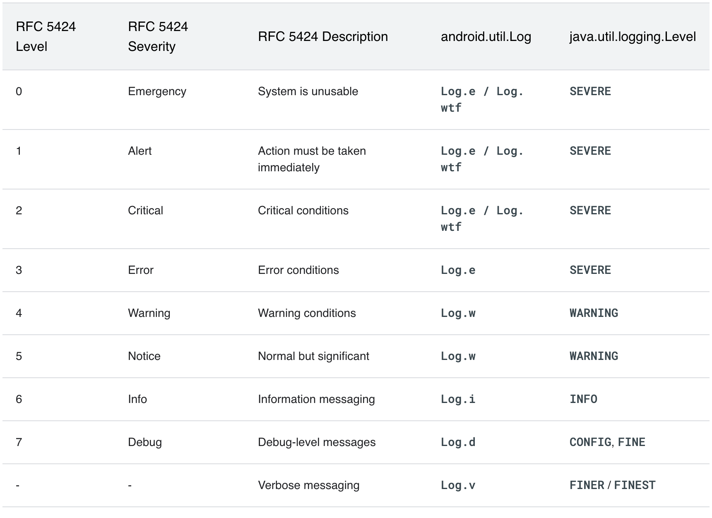
Logging

Slide 116
Create new activity
Right click main package> New > Activity > Empty view activity
“PokemonDetailActivity”
** Check declare activity in androidManifest.xml**

Slide 117
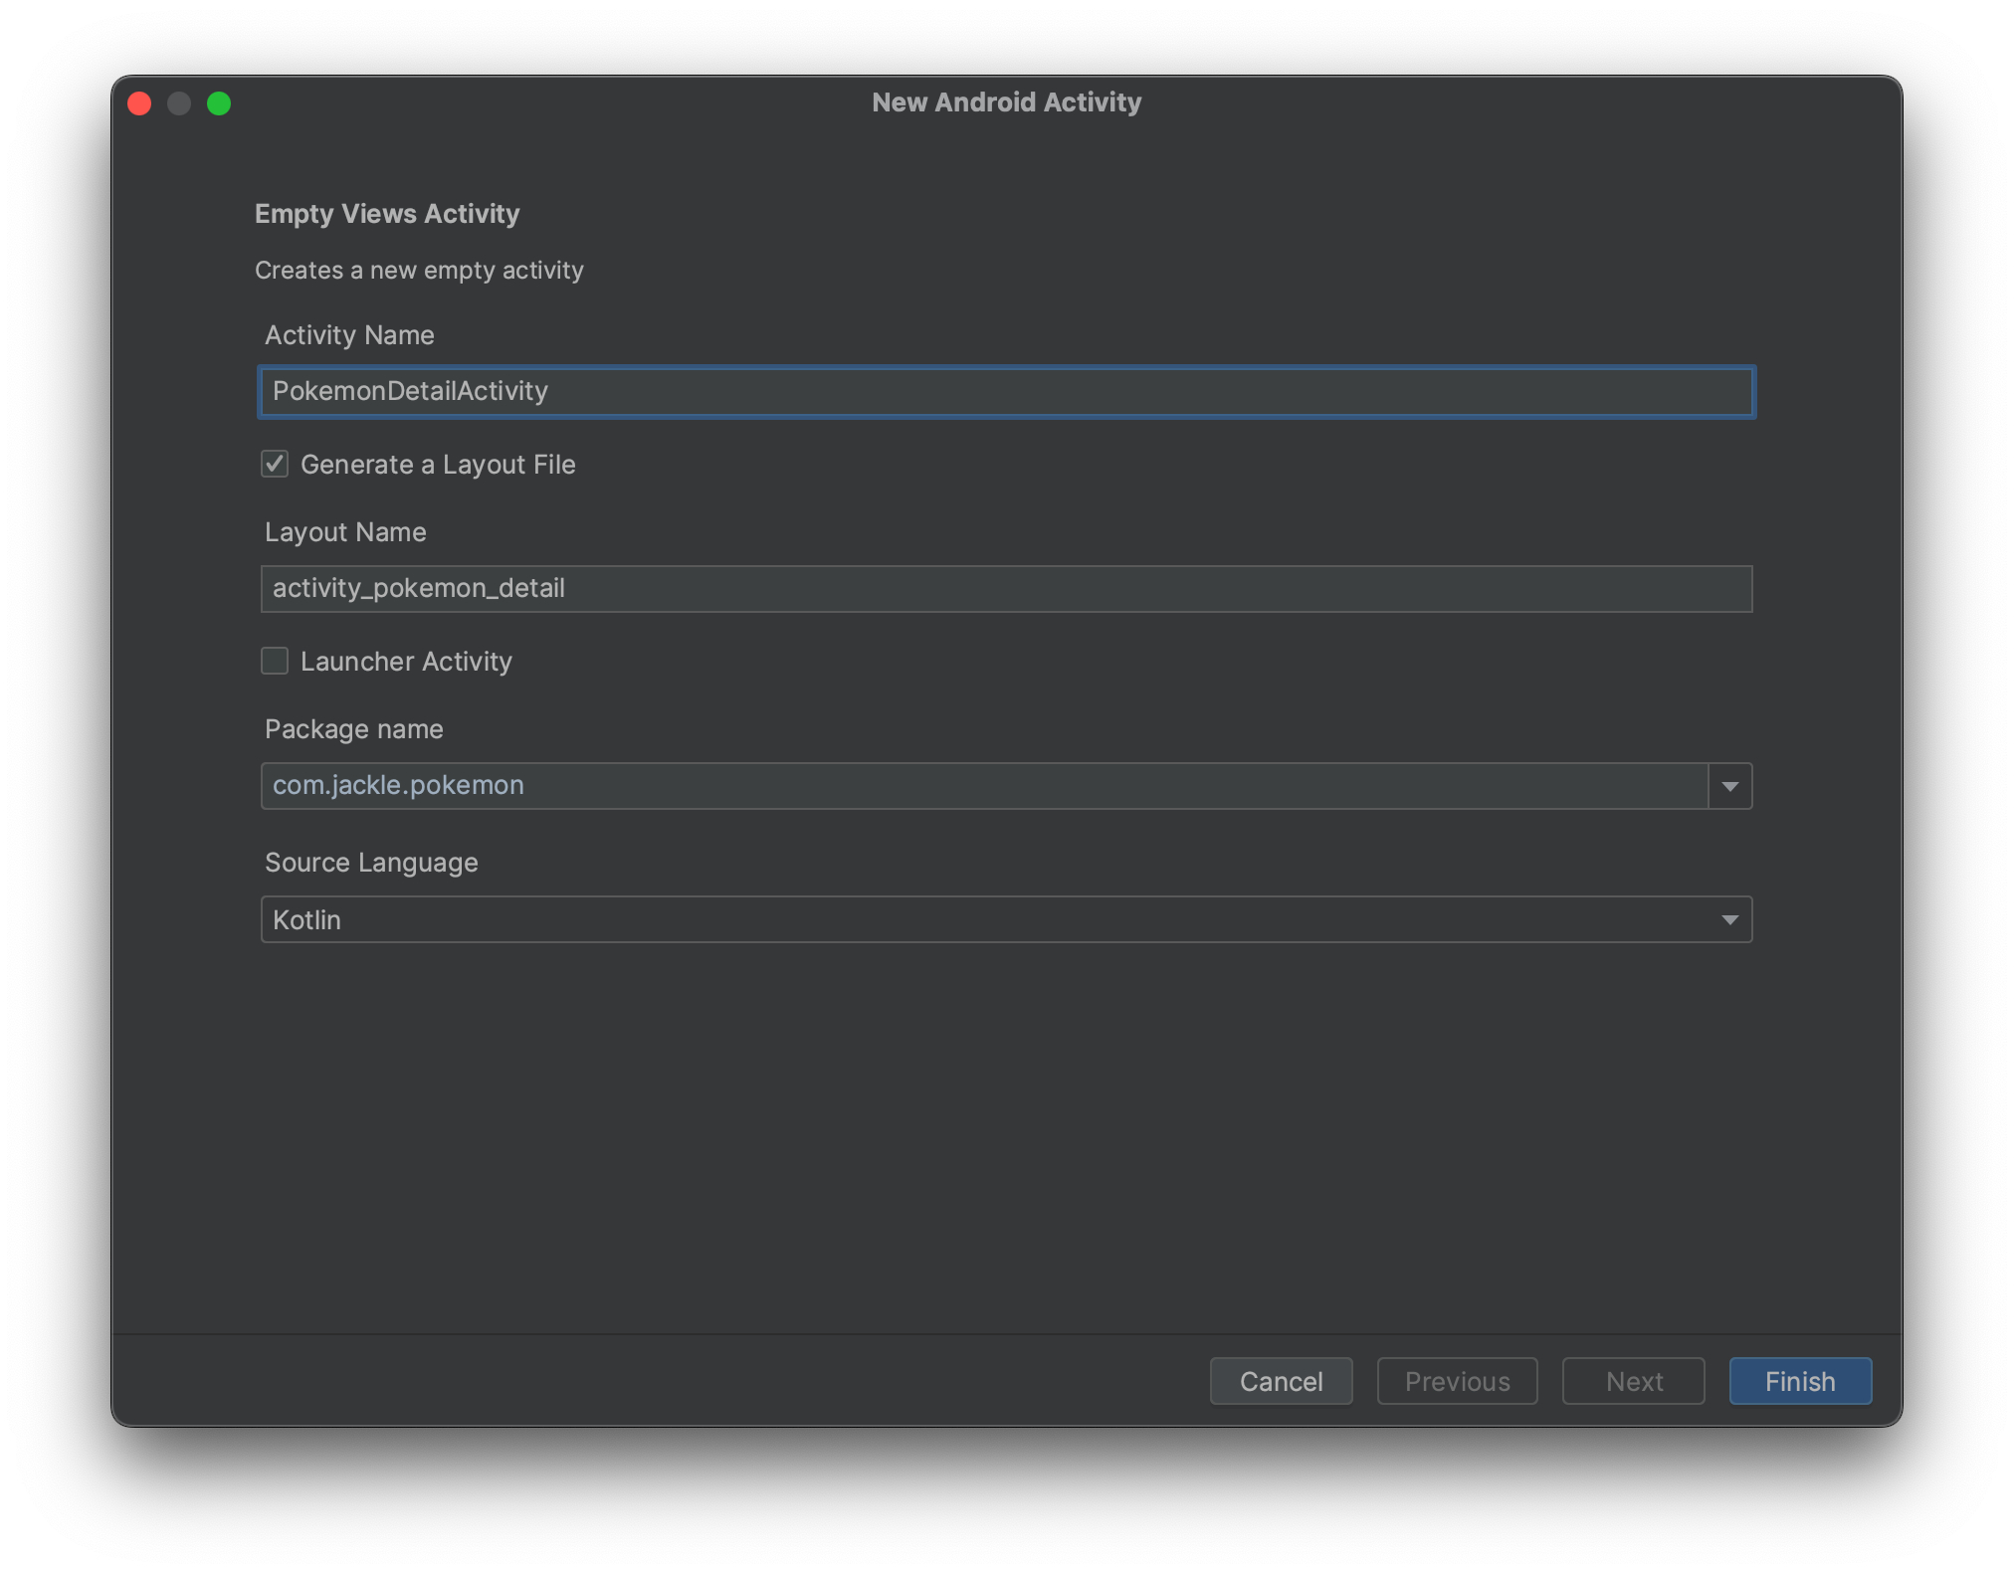

Slide 118
Create new activity layout
Activity class > PokemonDetailActivity.kt
Layout > activity_pokemon_detail.xml

Slide 119
Navigate to new activty
val intent = Intent(this, PokemonDetailActivity::class.java)
startActivity(intent)

Slide 120
Layout part 2
View
RecyclerView
Action to view
Notes:
15:30 - 16:30

Slide 121
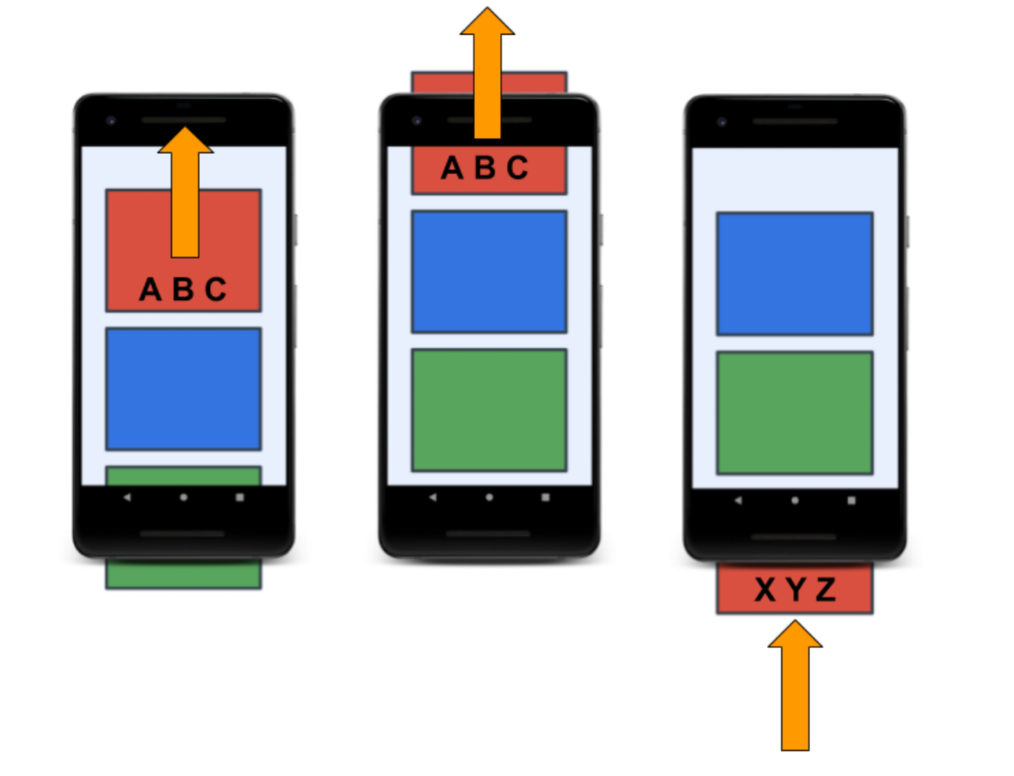
RecyclerView Concept

Slide 122
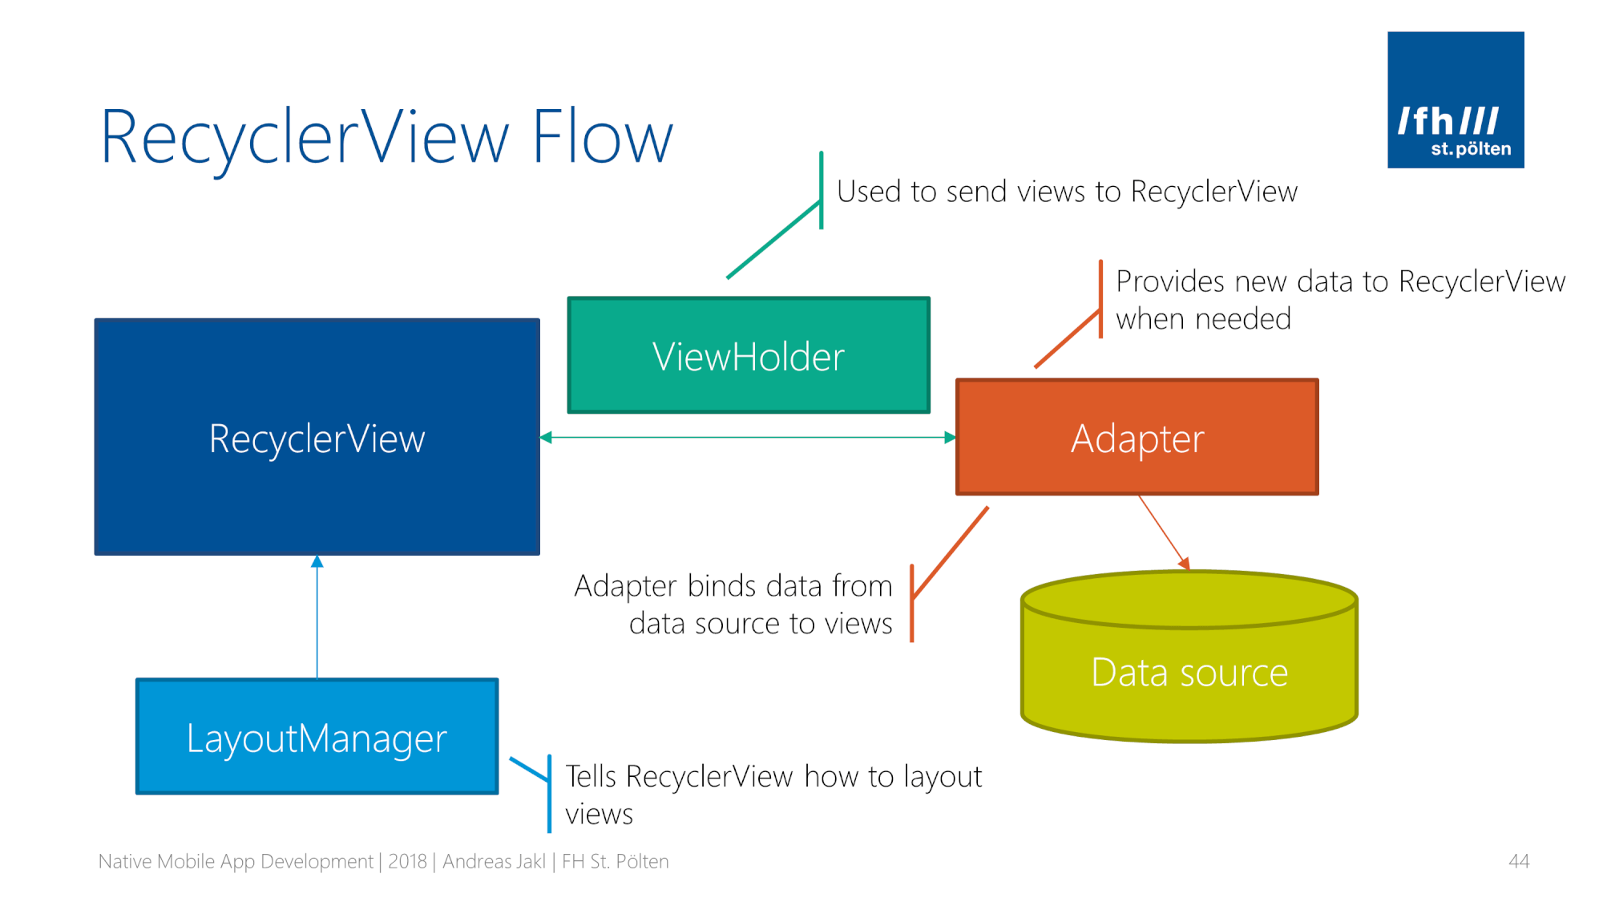
RecyclerView Concept

Slide 123
RecyclerView
Create Layout for RecyclerView item
Create data model for RecyclerView item
Create ViewHolder and bind data to view
Create Adapter
Create recyclerView and Layoutmanager
Set adapter to recyclerView
Handle click on item

Slide 124
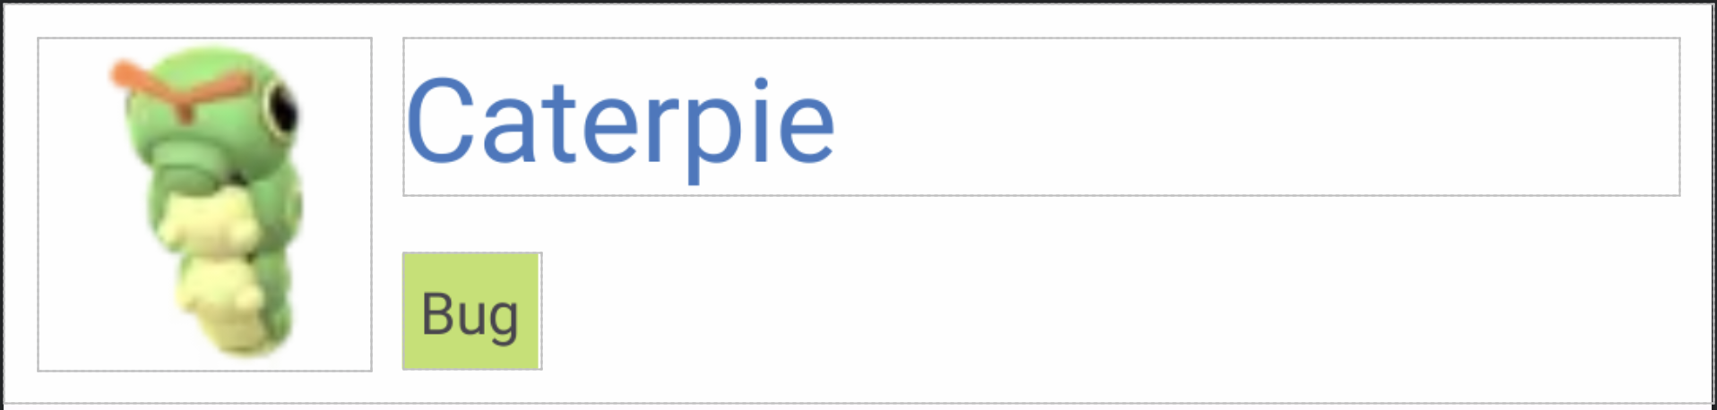

Create Layout for RecyclerView item
ConstraintLayout
- width match_parent
- height wrap_content
- padding: 8dp
- background #FEFEFE
Imaview
- width, height 80dp
TextView (Name)
- size 28sp - color #4078c0
TextView (Type)
- padding 4dp - color #C0E167

Slide 125
Create data model for RecyclerView item
data class Pokemon(
val id: Int,
val name: Name,
val type: List<String>,
val hp: Int,
val attack: Int,
val defense: Int,
val speed: Int,
val imageUrl: String
)
data class Name(
val english: String,
val japanese: String
)
https://gist.github.com/eye-bs/3e8f952a1cfde96ac457e2212c61f754

Slide 126
Create ViewHolder and bind data to view
class PokemonViewHolder(
private val bind: PokemonCardItemBinding
) : ViewHolder(bind.root) {
fun bindView(pokemon: Pokemon) {
pokemon.apply {
bind.nameTv.text = name
bind.typeTv.text = type.joinToString(", ")
bind.imageView.background =
ContextCompat.getDrawable(
bind.imageView.context,
R.drawable.caterpie
)
}
}
}

Slide 127
Create Adapter and set to RecyclerView
class PokemonAdapter(
private val pokemonList: List<Pokemon>
) : Adapter<PokemonViewHolder>() {
override fun onCreateViewHolder(parent: ViewGroup, viewType: Int): PokemonViewHolder {
val inflater = LayoutInflater.from(parent.context)
val view = PokemonCardItemBinding.inflate(inflater, parent, false)
return PokemonViewHolder(view)
}
override fun getItemCount(): Int = pokemonList.size
override fun onBindViewHolder(holder: PokemonViewHolder, position: Int) {
holder.bindView(pokemonList[position])
}
}

Slide 128
Create recyclerView and Layoutmanager
<androidx.constraintlayout.widget.ConstraintLayout>
…
<androidx.recyclerview.widget.RecyclerView
android:layout_width="match_parent"
android:layout_height="match_parent"
android:orientation="vertical"
app:layoutManager="androidx.recyclerview.widget.LinearLayoutManager"
app:layout_constraintBottom_toBottomOf="parent"
app:layout_constraintEnd_toEndOf="parent"
app:layout_constraintStart_toStartOf="parent"
app:layout_constraintTop_toTopOf="parent" />
</androidx.constraintlayout.widget.ConstraintLayout>
Notes:
Must be done by first day

Slide 129
Fragment
Lifecycle
supportFragmentManager
Notes:
Must start at 09:30 - 10:00

Slide 130
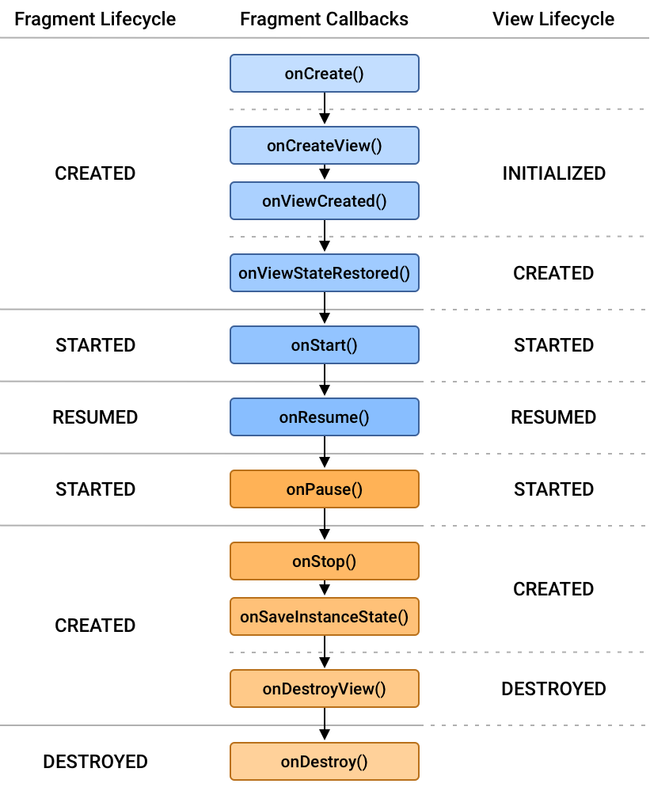
Fragment lifecycle

Slide 131
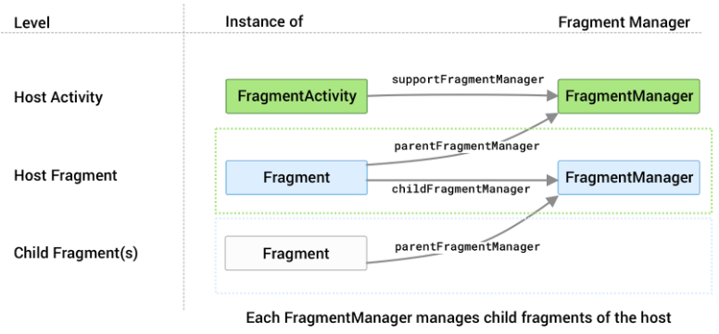
Fragment Manager

Slide 132
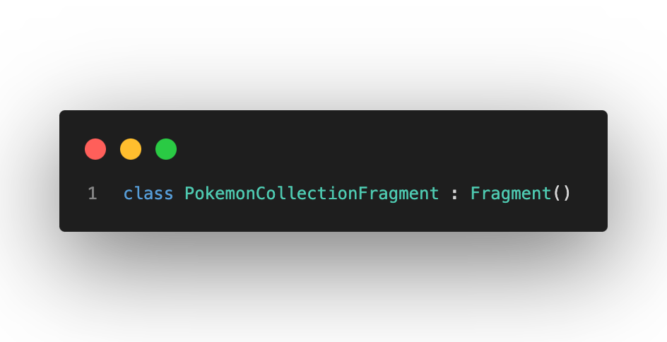
Transform Activity to fragment
Change from Extend Activity() to Fragment()

Slide 133
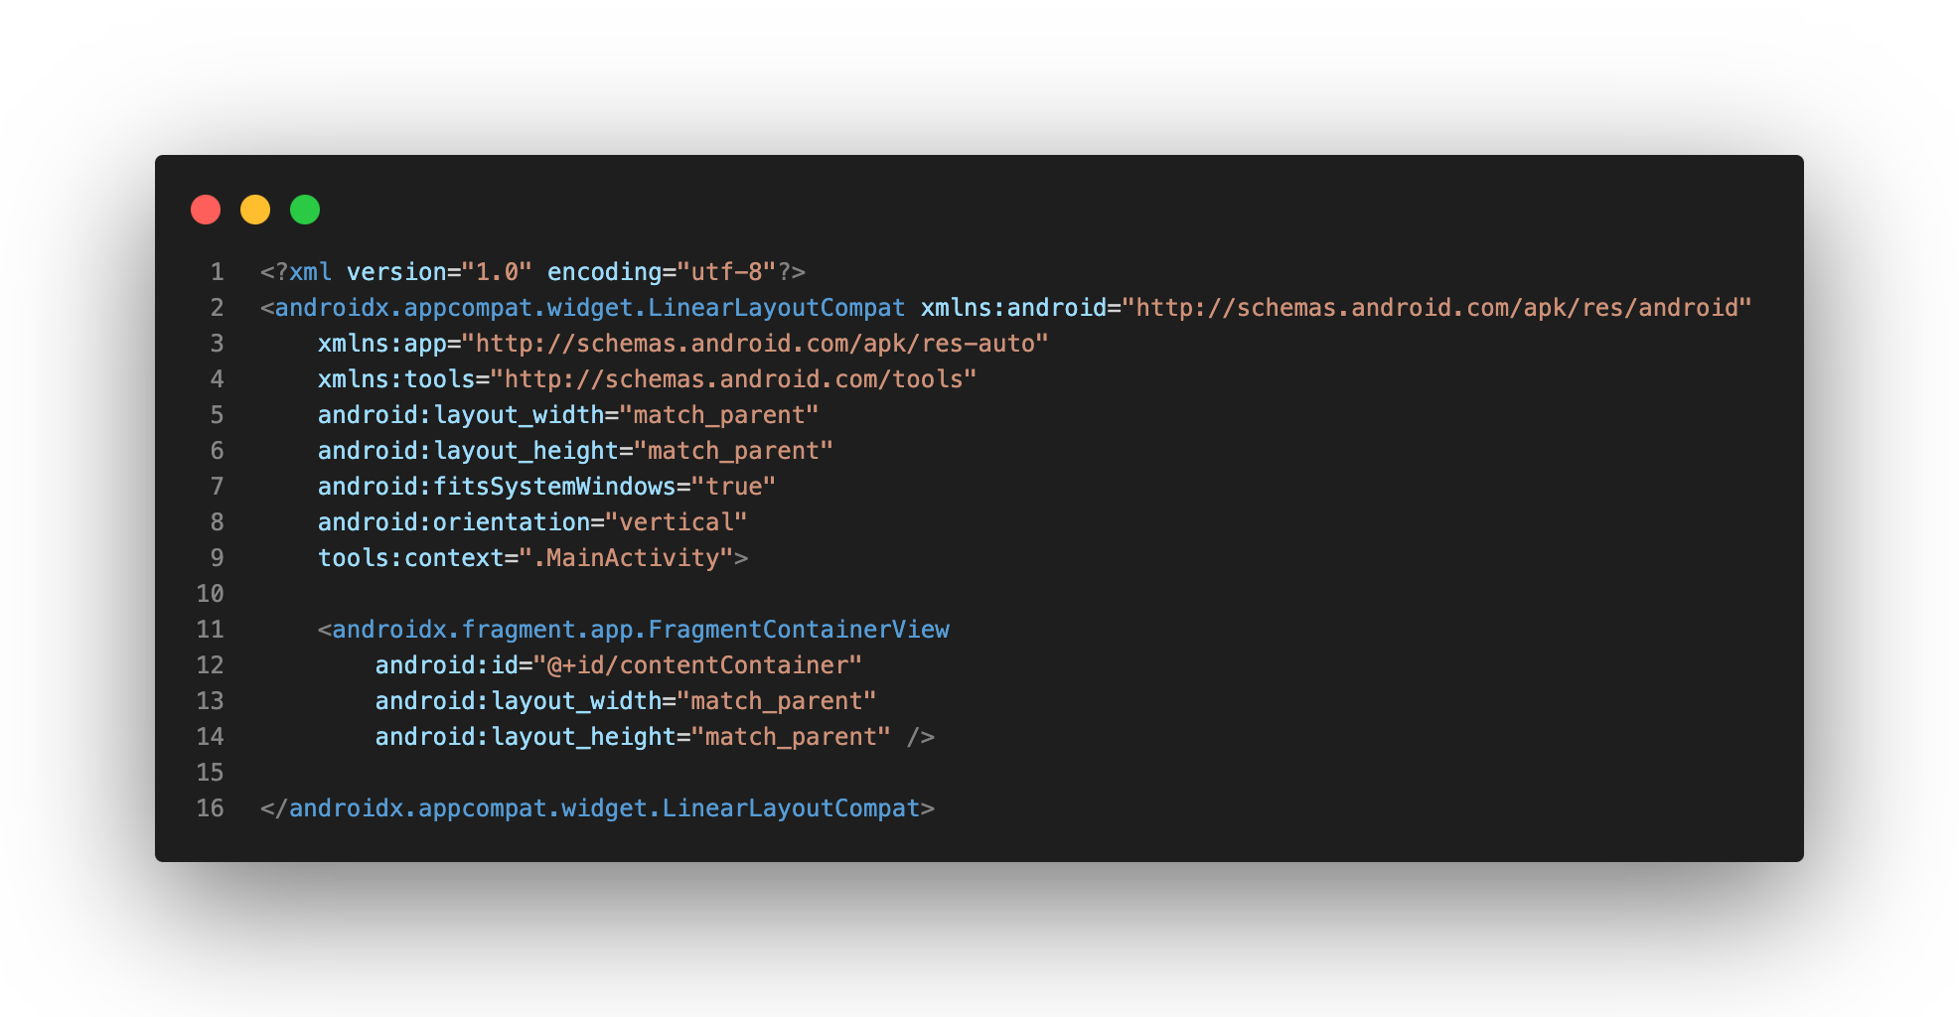
Transform Activity to fragment
Prepare layout in activity for replace fragment

Slide 134
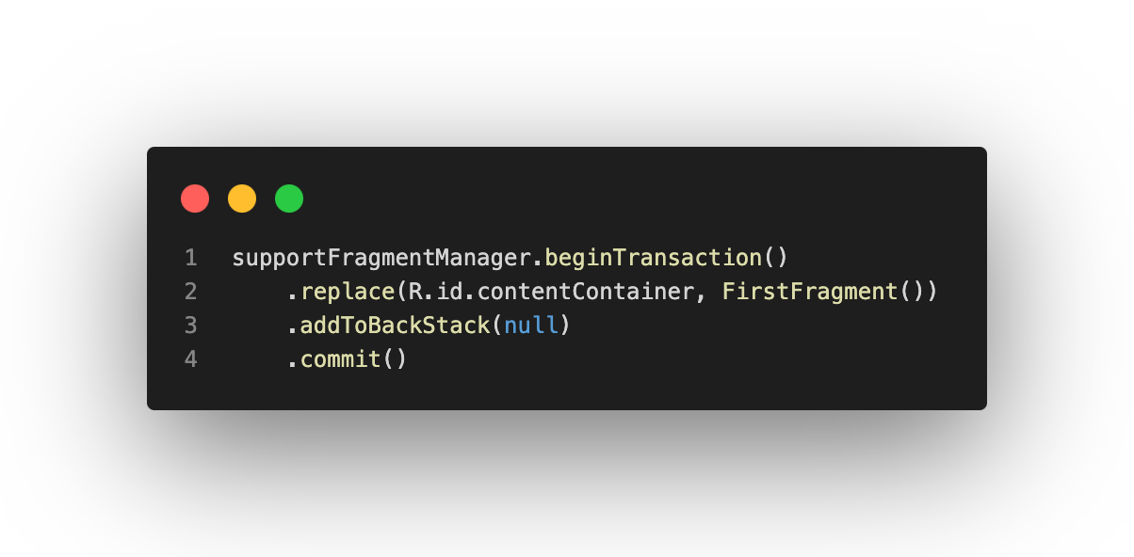
Transform Activity to fragment
Replace contentContainer with FirstFragment by fragment manager

Slide 135
Navigation Component
Notes:
10:00 - 10:30

Slide 136
Benefit
Handling fragment transactions
Handling Up and Back actions correctly by default
Providing standardized resources for animation and transitions
Implementing and handling deep linking
Including Navigation UI patterns, such as navigation drawers and bottom navigation, with minimal additional work
Including Safe Args, a Gradle plugin that provides type safety when navigating and passing data between destinations
Providing ViewModel support

Slide 137
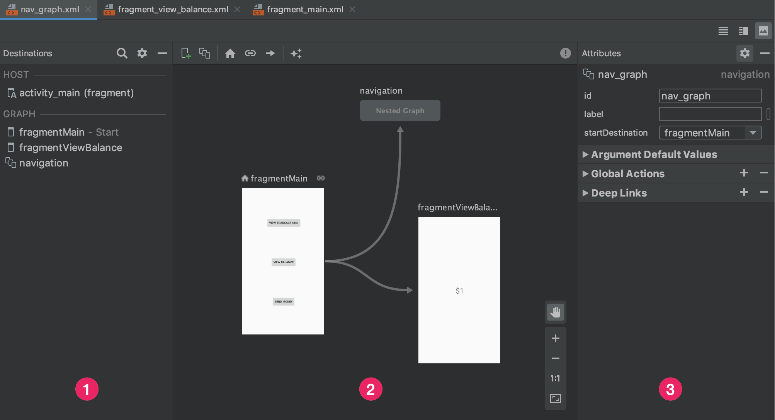
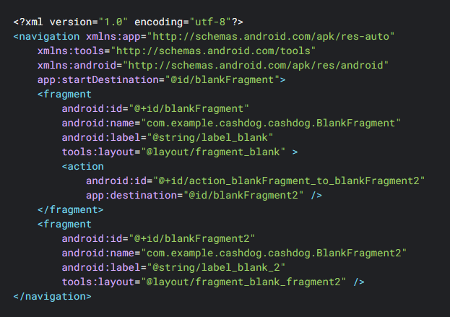
Navigation Graph

Slide 138
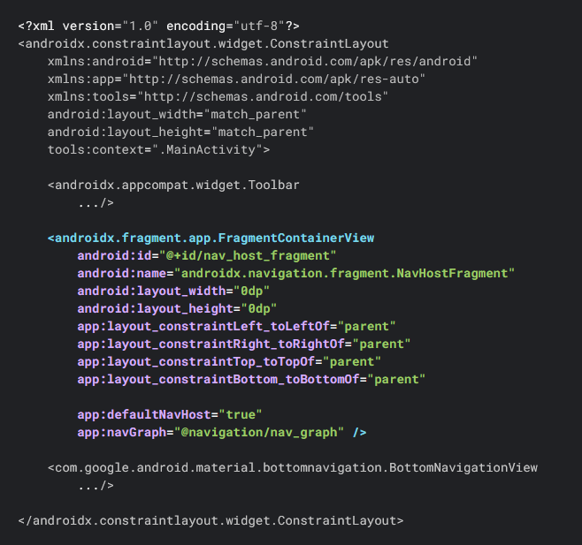
NavHost

Slide 139
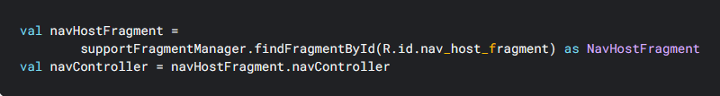
NavController
Fragment.findNavController()
View.findNavController()
Activity.findNavController(viewId: Int)

Slide 140
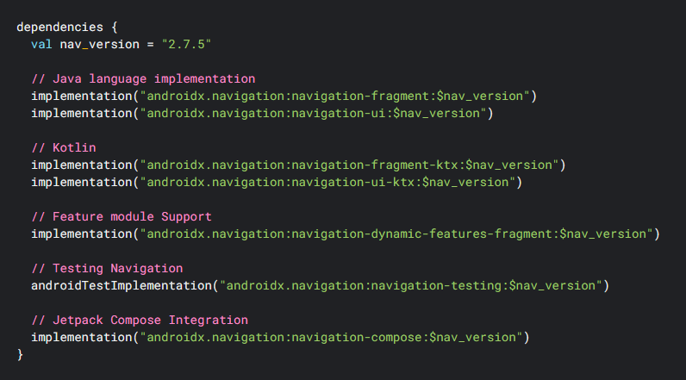
Set up environment

Slide 141
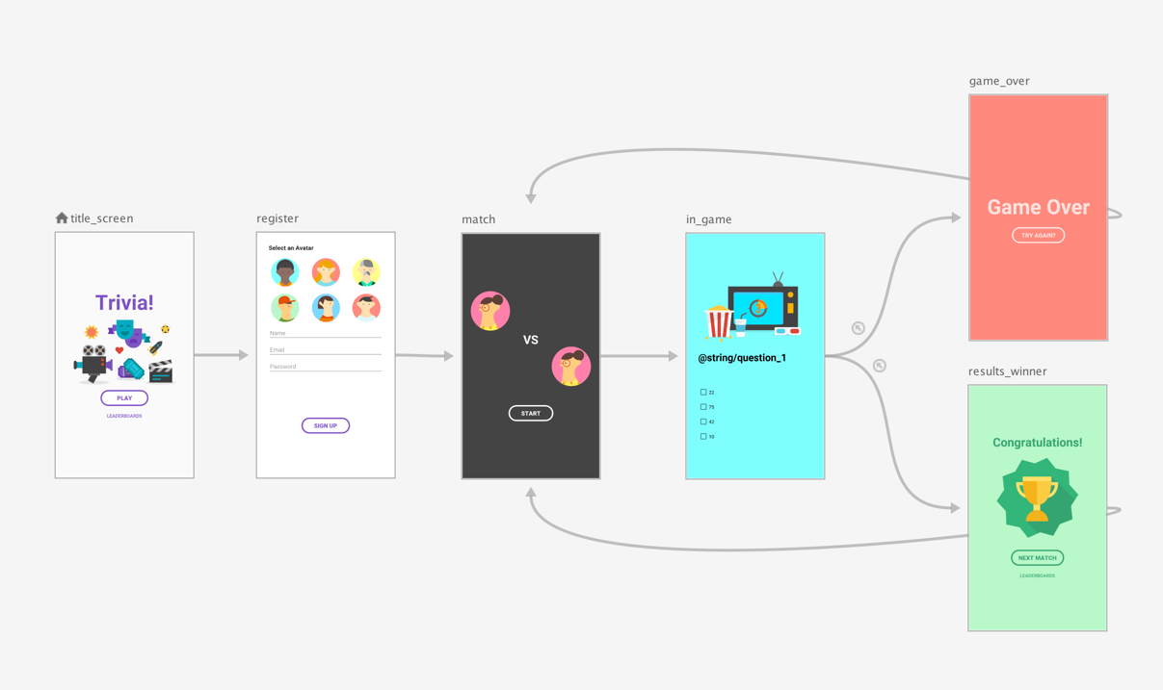
Top-level nav graph

Slide 142
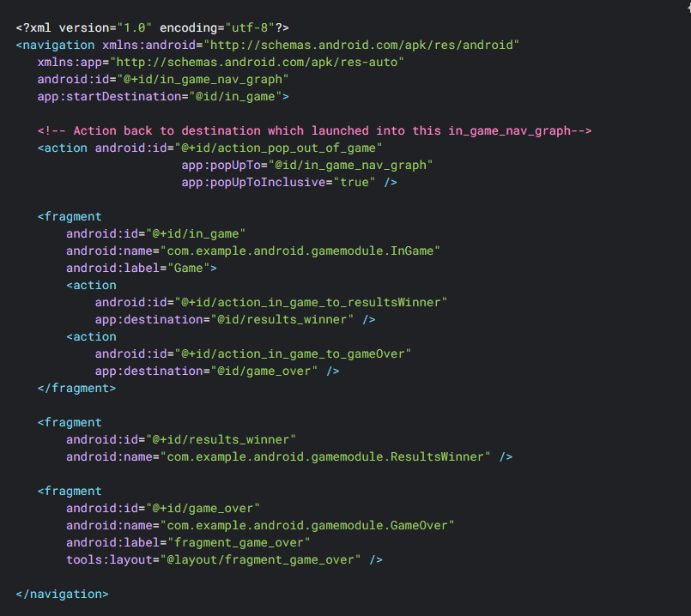

Slide 143
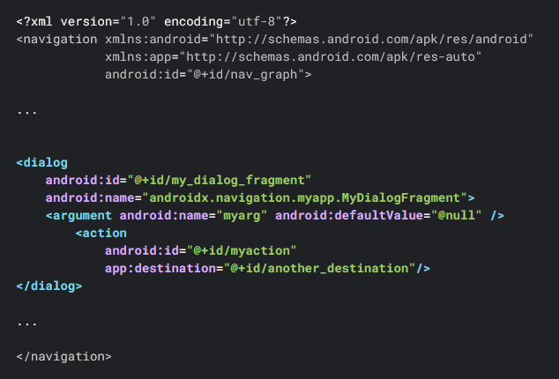

Slide 144
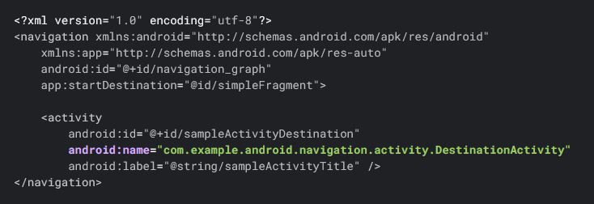

Slide 145

<fragment
android:id=”@+id/specify_amount_fragment”
android:name=”com.example.android”
android:label=”SpecifyAmount”>
<action
android:id=”@+id/action_specify_amount_fragment_to_confirmation_fragment”
app:destination=”@id/confirmation_fragment” />
</fragment>
view
.findNavController()
.navigate(R.id.action_specify_amount_fragment_to_confirmation_fragment)

Slide 146
navController.popBackStack()
navController.popBackStack(R.id.destinationId, true)
navController.popBackStack(R.id.destinationId, false)

Slide 147
D
C
B
A

Slide 148
D
popBackStack()
C
B
A

Slide 149
D
popBackStack(
R.id.B,
false
)
C
B
A

Slide 150
D
popBackStack(
R.id.B,
true
)
C
B
A

Slide 151

Navigate with options

Slide 152
Pass data between
destination
<fragment
android:id="@+id/specify_amount_fragment"
android:name=”com.example.android.SpecifyAmountFragment”>
<action
android:id=”@+id/confirmation_action”
app:destination=”@id/confirmation_fragment” />
</fragment>
<fragment
android:id="@+id/confirmation_fragment"
android:name=”com.example.android.ConfirmationFragment”>
<argument
android:name=”amount”
app:argType=”integer” />
</fragment>
override fun onClick(v: View) {
val amountTv: EditText = view!!.findViewById(R.id.edtAmnt)
val amount = amountTv.text.toString().toInt()
val action =
SpecifyAmountFragmentDirections
.confirmationAction(amount)
v.findNavController().navigate(action)
}

Slide 153


Transition Animation

Slide 154

Nested graphs

Slide 155



Slide 156
Architecture Component
UI Libraries
Data Libraries
Notes:
10:30 - 11:10 (+ Presentation MVVM to Create Instance of ViewModel)

Slide 157
Architecture Component
UI layer libraries
View Binding*
Data Binding
Lifecycler aware component*
Paging libraries
Data layer libraries
Data store
Work manger

Slide 158
Lifecycler aware components
ViewModel*
LiveData
Save UI State*

Slide 159
Presentation Architecture MVVM

Slide 160

MVVM

Slide 161

ViewModel lifecycle

Slide 162
Add architecture component to app
val lifecycle_version = "2.6.2"
val arch_version = "2.2.0"
implementation("androidx.fragment:fragment-ktx:1.6.2")
// ViewModel
implementation("androidx.lifecycle:lifecycle-viewmodel-ktx:$lifecycle_version")
// ViewModel utilities for Compose
implementation("androidx.lifecycle:lifecycle-livedata-ktx:$lifecycle_version")
// Saved state module for ViewModel
implementation("androidx.lifecycle:lifecycle-viewmodel-savedstate:$lifecycle_version")
// optional - Test helpers for LiveData
testImplementation("androidx.arch.core:core-testing:$arch_version")

Slide 163
Create new viewModel
ViewModel class > HomeViewModel.kt

Slide 164
ViewModel scoping APIs
viewModel()
activityViewModels()

Slide 165
Create instance of viewModel
private val viewModel by viewModels<HomeViewModel>()

Slide 166
Dependencies Injection

Slide 167
Dependency
Manual
Hilt Dagger

Slide 168

Dependency

Slide 169


Slide 170

Manual

Slide 171



Manage with container

Slide 172


Hilt Dagger
build.gradle
app/build.gradle

Slide 173


Application
Android Classes

Slide 174

ViewModel

Slide 175



Slide 176


Slide 177


Slide 178


Slide 179


Slide 180


Slide 181



Slide 182

Notes:
Must be done by 14:00

Slide 183
Permission
Notes:
Must done this topic by 12:00

Slide 184

Permissions

Slide 185

Workflow for using permissions

Slide 186
Type of permissions
Feature | Install-time Permission | Normal Permission | Runtime Permission | Permission Group
Approval timing | Automatic (install/update) | Automatic (install/update) | At runtime (dynamically) | Automatic (install/update)
Risk level | Low | Lowest | High | Varies within group
Examples | Internet, storage, vibration | Set wallpaper, change network state | Camera, location, contacts | Camera, audio, microphone

Slide 187
Define permission
<uses-permission android:name="android.permission.INTERNET" />
<uses-permission android:name="android.permission.ACCESS_NETWORK_STATE" />

Slide 188

Runtime permissions example
Manifest declarations

Slide 189




Slide 190
Connecting APIs
Http client Retrofit & okhttp
Notes:
Start 13:00 - 13:40
Connecting APIs
Create Network module

Slide 191
Retrofit & Okhttp
Retrofit
retrofit is type-safe REST client for Android and Java which aims to make it easier to consume RESTful web services
has many features like easy to add custom headers and request types, file uploads, mocking responses, etc
Okhttp
efficient HTTP & HTTP/2 client for Android and Java applications.
It comes with advanced features, such as connection pooling (if HTTP/2 isn’t available), transparent GZIP compression, and response caching, to avoid the network completely for repeated requests.

Slide 192
Add retrofit & okhttp to app
implementation("com.squareup.retrofit2:retrofit:2.9.0")
implementation("com.squareup.retrofit2:converter-gson:2.9.0")
implementation("com.squareup.okhttp3:okhttp:4.11.0")
implementation("com.squareup.okhttp3:logging-interceptor:4.11.0")
implementation("com.google.code.gson:gson:2.9.1")

Slide 193
Create okhttp with logging
val logger = HttpLoggingInterceptor()
logger.level = HttpLoggingInterceptor.Level.BODY
return OkHttpClient.Builder()
.addInterceptor(logger)
.build()
baseUrl = https://my-json-server.typicode.com/jackleStyle0/jackle-st/

Slide 194
Define Http API with interface
interface PokemonApi {
@GET("/pokemons")
fun getPokemonList(): Response<List<Pokemon>>
}
The Retrofit class generates an implementation of the PokemonAPI interface.
fun createAPI(): PokemonApi {
return createRetrofit().create(PokemonApi::class.java)
}

Slide 195
Kotlin part 2
Coroutine
flow
Notes:
Start 13:40

Slide 196
Coroutine
Threads
With Context
Scope
CoroutineBuilder
Dispatchers
Suspend Functions

Slide 197
Thread
IO — Used for Disk or Network Applications
Main — Used for updating UI
Default — Used for CPU-intensive Applications

Slide 198
Scope
Define the lifetime of the coroutines
GlobalScope
ViewModelScope
LifecyclerScope
CoroutineScope

Slide 199
Dispatchers
Used to decide the thread of the coroutines
Dispatchers.Io
Dispatchers.Main
Dispatchers.Default

Slide 200

Suspend Function

Slide 201

sytax
1
Scope
2
Context
3
CoroutineBuilder
4

Slide 202
Get pokemonList from API
fun getPokemonList() {
viewModelScope.launch {
val pokemonList = PokemonFactoryApi.createAPI().getPokemonList()
if (pokemonList.isSuccessful) {
Log.d(MainViewModel::class.java.simpleName, “Api success")
} else {
Log.d(MainViewModel::class.java.simpleName, "Api error")
}
}
}

Slide 203
Flow
Serves as a reactive programming framework
Data streams
Asynchronous observers
Flow is a coroutine that can emit multiple values over a period of time

Slide 204
Flow
Use case
Retrieve data from database and filtering
Render UI that combines data from multiple data sources
Render real-time data for stock prices
Show autocomplete search result

Slide 205
Flow
Cold flow
Hot flow
StateFlow
ShareFlow

Slide 206
Flow
Operators
Filters
Map
Take
Debounce
FlatmapMerge
FlatmapConcat
Buffer
Combine
Zip
Terminal operators
first
last
count
reduce
fold
https://flowmarbles.com/

Slide 207
Flow
StateFlow
ShareFlow

Slide 208
Repository

Slide 209
Repository
PokemoRepository
Implementation
getPokemonList(): Flow<List<Pokemon>>
API
PokemonRepository Interface
Local

Slide 210
Repository
class PokemonRepositoryImpl(private val api: PokemonApi) : PokemonRepository {
override fun getPokemonList(): Flow<List<Pokemon>> = flow {
val res = api.getPokemonList()
val body = res.body()
if (res.isSuccessful && body != null) {
emit(body)
} else {
throw Exception()
}
}
}

Slide 211
Update UI state with flow
private val _uiState = MutableSharedFlow<Pokemon>()
val uiState: SharedFlow<Pokemon> = _uiState.asSharedFlow()
viewModelScope.launch {
repository.getPokemonList()
.flowOn(Dispatchers.IO)
.catch { Log.d(MainViewModel::class.java.simpleName, ">> error") }
.collect {
val pokemon = randomPokemon(it)
_uiState.emit(pokemon)
}
}

Slide 212
Data and file Storage
App specific storage
Share storage
Preference
Database
Notes:
Start 15:00 - 15:30

Slide 213
Data and file storage
Android storage
Internal storage
External storage

Slide 214
Data and file storage
App external storage
External storage
Shared storage

Slide 215
Data and file storage
External storage
Need permission to access
All applications can read and write files placed
App external storage
Same as internal storage but user can manage
When the user uninstalls, file are removed
Shared storage
When the user uninstalls, file are not removed
Case study payment/transfer slip

Slide 216
Data and file storage
⭐️
App preferences
Cache
Internal storage
Database
File

Slide 217
Data and file storage
Internal storage
When the user uninstalls your app, the files saved in app-specific storage are removed.
Other apps cannot access files stored within internal storage.
Available storage will display the total internal storage capacity in application information

Slide 218

Data and file storage
Share Preferences
Store data in the form of key-value similar to a Map
Save folder under data/data/{application package} directory.
Avoid calling it from your main thread because it could pause your UI rendering.

Slide 219

Data and file storage
Share Preferences
Write to shared preference

Slide 220

Data and file storage
Share Preferences
Read from shared preference

Slide 221

Data and file storage
Share Preferences
Remove from shared preference

Slide 222

Data and file storage
Share Preferences
Clear from shared preference (remove all keys)

Slide 223
Data and file storage
Share Preferences
Create extension for set and get list value to share preferences
inline fun <reified T> SharedPreferences.get(key: String, default: T): T {
return try {
Gson().fromJson(this.getString(key, null), object : TypeToken<T>() {}.type) ?: default
} catch (e: JsonSyntaxException) {
default
}
}
fun <T> SharedPreferences.set(key: String, value: T) {
this.edit().putString(key, Gson().toJson(value)).apply()
}

Slide 224
Loading Image

Slide 225
Loading Image
build.gradle
dependencies {
…
implementation("com.github.bumptech.glide:glide:4.16.0")
}
Create imageView
<ImageView
android:id="@+id/pokemonImage"
android:layout_width="300dp"
android:layout_height="300dp"
android:layout_marginTop="24dp"/>

Slide 226
Loading Image
Create function to load image
private fun ImageView.loadImage(url: String) {
Glide
.with(this)
.load(url)
.centerCrop()
.into(this)
}
Implement
binding.pokemonImage.loadImage(imageUrl)

Slide 227
Handle State Lifecycle

Slide 228
*Activity [Yao]
Lifecycle
startActivity
Pass data between activity
Device[EYE]
Support different pixel densities
*Layout part2[EYE]
View
RecyclerView
Action to view
*Fragment [Teema]
Lifecycle
supportFragmentManager
*Navigation component [Teema]
Architecture component[Yao]
View binding
Lifecycler aware
*ViewModel
*Presentation architecture MVVM [Yao]
*Dependencies injection [Teema]
Permission [Tarn]
*Network [Tarn]
Retrofit
*Kotlin part 2
Coroutine[Yao]
Flow [Ake]
Data and file storage [Nine]
App specific storage
Share storage
*Preference -> data store
Database
Device local storage
*Loading image [EYE]
*Handle state lifecycle[Yao]
*Repository[Yao]
*Lottie[EYE]
ลงชื่อท้ายหัวข้อที่สนใจ [xxx]
Android course
Project structure [Yao]
Gradle Configuration [Yao]
minSDK
compileSDK
targetSDK
Context [Yao]
Resource [Yao]
String
Theme
Style
Attr
Manifest [Yao]
*Layout1[EYE]
ViewGroup
View
TextView
Button
ImageView
Kotlin part1
Variable Declaration[EYE]
Type[EYE]
Nullable
expression[EYE]
Control flow[EYE]
condition
loop
Working with null[EYE]
collection[EYE]
List
Set
Pair
Function [Teema]
First class function
Scope function
Extension function
Higher order function
Lamda
Inline functions
Operator function
infix function
Class and Object [Teema]
Class
Visibility modifiers
Data class
Enum class
Seal class

Slide 230
Random in collection

Slide 231
val pokemonList = listOf(
"Bulbasaur" to "ฟุชิกิดาเนะ",
"Ivysaur" to "ฟุชิกิโซ",
"Venusaur" to "ฟุชิกิบานะ",
"Charmander" to "ฮิโตคาเงะ",
"Squirtle" to "เซนิกาเมะ",
"Caterpie" to "คาเตอร์ปี",
"Weedle" to "บีเดิล",
"Pidgey" to "ป็อปโปะ",
"Rattata" to "โครัตตา",
"Pikachu" to "พิคาชู",
)

